Slide 1


Spring 2024 Enrollment Information Session
Friday November 3
Notes:
Insert any pre-title text in the text box at the top (ie. “Presented by…”)
Insert the presentation title in the second text box with the largest text
Insert the speaker’s name and/or the month, day and year of the presentation.
Delete any text boxes you didn’t use.
You are welcome to use the image that is already included. For instructions on how to change the image, view slide 6. In order to keep the transparent look, change the picture’s transparency to 75% in the ”Picture format” pane that should pop up on the right side of the screen.

Slide 2
Agenda
Key Resources
Important Dates
The NSHA Curriculum
Key Takeaways from the 4 Year Degree Planning Assignment
Answering Your Questions!
Cornell Nolan School of Hotel Administration 2
Notes:
Delete this slide before completing your presentation

Slide 3
Getting Answers
STEP 1
USE YOUR RESOURCES
STEP 2
ATTEND VIRTUAL 1:1 ADVISING DROP-INS
STEP 3
E-MAIL THE ADVISING TEAM
If you have questions, please follow this process!
MAKE AN APPOINTMENT
Student Launchpad
Degree Audit
Student Handbook
Enrollment Resources
Opportunity to meet with an advisor individually without an appointment!
Offered via Zoom
Students are seen on ‘first come first served’ basis
See the Resources for Students webpage for SP24 Pr- Enrollment Drop-In Schedule and Zoom Link
Individual 30 minute scheduled appointments are intended for students who wish to discuss long term goals and want to do complex planning related to those goals.
Please do not make an appointment for a quick question that could be answered in drop-ins or via email
STEP 4
ha-advising@cornell.edu
Expect a response time of up to 2 business days
Notes:
Delete this slide before completing your presentation

Slide 4
Use Your Resources!
Student LaunchPad
Student Essentials
  Links you to your Student Center to view your pre-enrolled core schedule and enroll in additional courses.
NSHA Resources for Students
  Pre-Enrollment FAQs
  These presentation slides!
  Core Swap Request Form & Instructions
  4 Year Planning Sheet
University Registrar Guide to Enrollment
Step by step instructions on how to add a class
Cornell Nolan School of Hotel Administration 4
Notes:
Delete this slide before completing your presentation

Slide 5
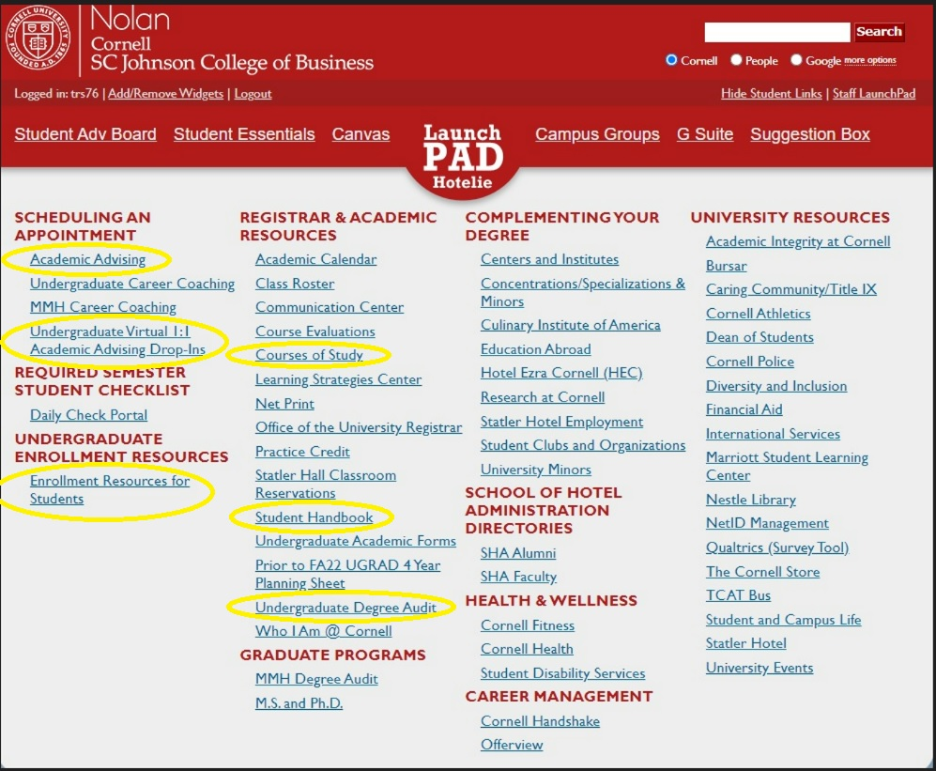
Student LaunchPad Website
Please note: The UGRAD 4 Year Planning Sheet is not relevant for the current fall 2022 curriculum – use the 4 year planning sheet linked on the NSHA Resources for Students page instead
Cornell Nolan School of Hotel Administration 5
Notes:
Delete this slide before completing your presentation

Slide 6
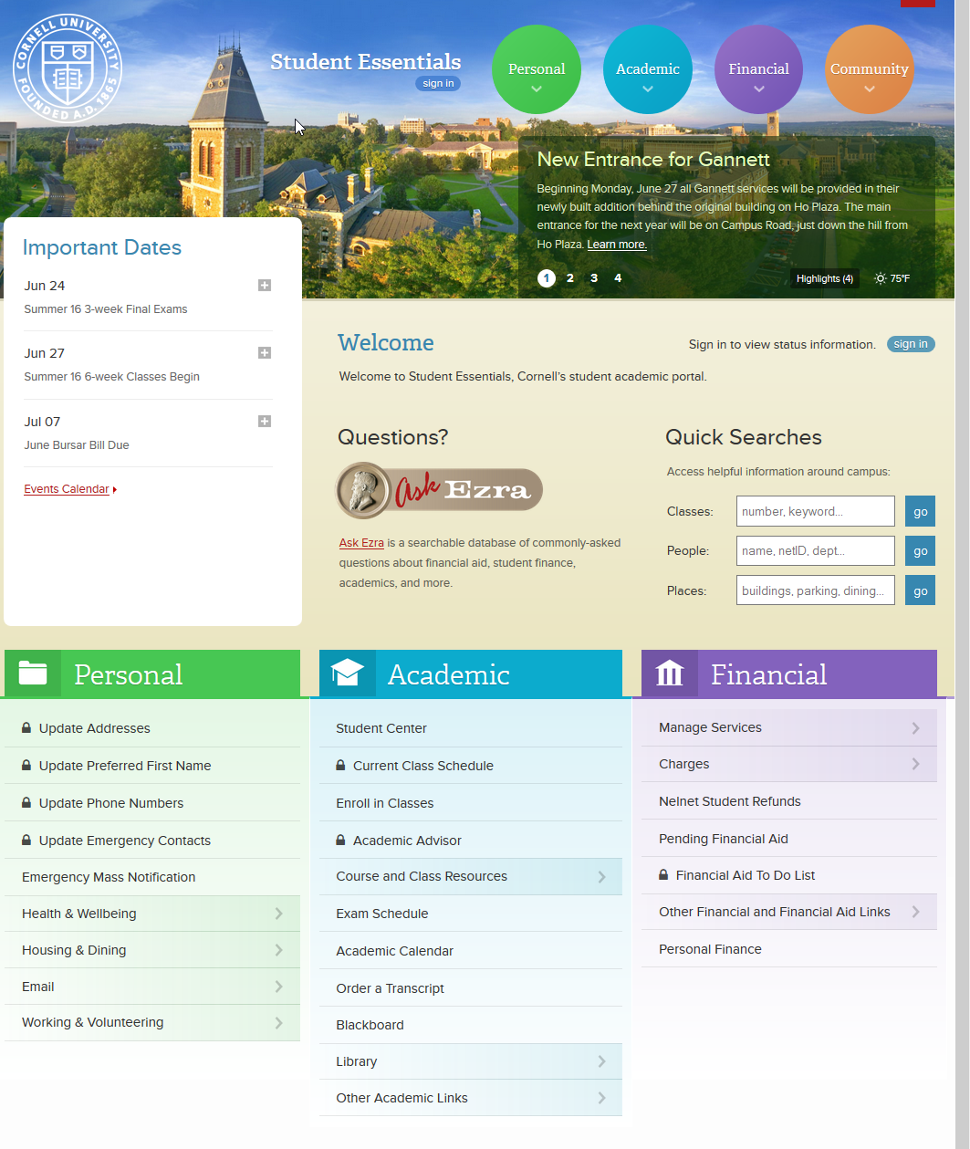
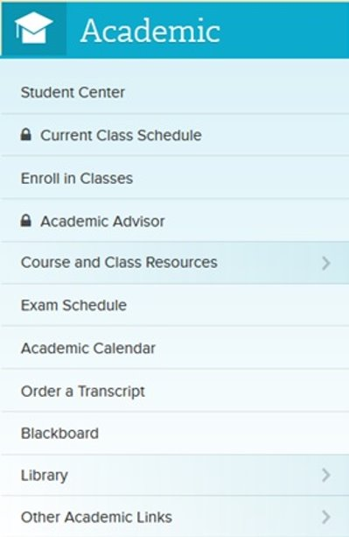
Student Essentials
Cornell Nolan School of Hotel Administration 6
Notes:
Delete this slide before completing your presentation

Slide 7
Virtual 1:1 Pre-Enrollment Drop-Ins
We will be holding Virtual 1:1 Pre-Enrollment Drop-Ins at the following times:
  Monday October 30 – Thursday November 2
    10:00am – 12:00pm
    2:00pm – 4:00pm
  Friday November 3
    10:00am – 12:00pm
    2:00pm – 3:00pm
  Monday November 6 – Thursday November 19
    10:00am – 12:00pm
    2:00pm – 4:00pm
  Friday November 10
    10:00am – 12:00pm
    2:00pm – 3:00pm
Drop-Ins are held via Zoom
Meeting ID: 946 8781 2347
Passcode: 624493
Cornell Nolan School of Hotel Administration 7
Notes:
Delete this slide before completing your presentation

Slide 8
Key Academic Dates
November 6 at 7:30am – November 8 at 11:59pm: Pre-Enrollment for Juniors
November 7 at 7:30am – November 9 at 11:59pm: Pre-Enrollment for Sophomores
November 8 at 7:30am – November 10 at 11:59pm: Pre-Enrollment for First Years
Review the 2023-2024 Key Academic Dates for more important dates and deadlines!
Pre-Enrollment is just the first round of enrollment. Students can still make adjustments to their schedules during the Add/Drop period starting in January.
Cornell Nolan School of Hotel Administration 8
Notes:
Delete this slide before completing your presentation

Slide 9
Undergraduate Degree Requirements
HADM Core
58 credits
Practice Credit
800 hours
University P.E.
Requirement
2 courses
HADM
Electives
12 credits
ARTS
Distribution
Electives
15 credits
Additional Distribution
Electives
Including FWS
21 credits
D&I
and
Ethics
6 credits
Free
Electives
8 credits
University
Swim Test
Requirement
(completed in 1st year)
120 Required Credits
Other Requirements
(not for academic credit)
Cornell Nolan School of Hotel Administration 9
Notes:
Delete this slide before completing your presentation

Slide 10
Hotel Administration (HADM) Core
1000-Level
HADM 1150: Org. Behavior & Leadership Skills
HADM 1210: Financial Accounting
HADM 1350: Intro. to Hotel Operations
HADM 1361: Principles of F&B Operations Mgmnt.
HADM 1410: Microeconomics
HADM 1650: Business Writing
HADM 1740: Business Computing
2000-Level
HADM 2011: Hospitality Quant. Analysis
HADM 2021: Critical Thinking & Mathematical Modeling in Operations
HADM 2210: Managerial Accounting
HADM 2220: Finance
HADM 2221: Principles of Hospitality Real Estate
HADM 2351: Restaurant Management
HADM 2430: Marketing Mgmnt. For Services
HADM 2560: Fundamentals Of Hospitality Development & Mgmnt.
HADM 2810: Human Resources Mgmnt.
3000-Level
HADM 3650: Persuasive Business Communication for Hospitality Leaders
HADM 3870: Business & Hospitality Law
4000-Level
HADM 4410: Strategic Mgmnt.
Students will be pre-enrolled into all 1000-level and about half of their 2000-level core.
Students can self-enroll in HADM 2021, HADM 2210, HADM 2221, HADM 2351 and HADM 2560, once they have met the course pre-requisites.​
Students must complete all 2000-level core by the end of their junior year. Students must also complete all 2000-level core before going abroad, if that is of interest.
Cornell Nolan School of Hotel Administration 10
Notes:
Delete this slide before completing your presentation

Slide 11
Core Class 'Blocks'
The Nolan School registrar team has pre-enrolled you into a Core Block as well as HADM 1410 Microeconomics for Spring 2024
Students are not permitted to drop 1000-level and 2000-level HADM core courses.
Holds
If you log in to your Student Center and do not see that you have been enrolled in classes, this likely means that you have a HOLD on your account. It is imperative that you take steps to release your hold(s) as soon as possible.
  To check your holds, first sign into your Student Center
  Next, check for ‘Holds’ on the right side of the screen
  Click on ‘Details’ to read more about your hold(s), and instructions on how to remove them
  Take the appropriate steps to remove the hold, and e-mail ha-registrar@cornell.edu to announce you have removed your hold(s)
If your holds are not removed by next week you will not be able to participate in pre-enrollment
Cornell Nolan School of Hotel Administration 11
Notes:
Delete this slide before completing your presentation

Slide 12
1000-Level Hotel Administration (HADM) Core
Fall | Spring
All Students
HADM 1199 – Hotelie LaunchPad (Students are pre-enrolled into this 1 credit course, but it is not considered a core course) | HADM 1410 – Microeconomics for the Service Industry
HADM 1910 – Distinguished Lectures in Hospitality Management (Students are pre-enrolled into this 1 credit course, but it is not considered a core course)
HADM 1740 - Business Computing
Block 1 Students | Block 1 Students
HADM 1210 – Financial Accounting | First Year Writing Seminar (Students must enroll themselves into a First Year Writing Seminar of their choice)
HADM 1350 – Introduction to Hotel Operations | HADM 1361 – Introduction to Foodservice Management
HADM 1650 – Business Writing | HADM 1150 – Organizational Behavior & Leadership Skills
Block 2 Students | Block 2 Students
First Year Writing Seminar (Students must enroll themselves into a First Year Writing Seminar of their choice) | HADM 1210 – Financial Accounting
HADM 1361 – Principles of Food & Beverage Ops. Mgmnt. | HADM 1350 – Introduction to Hotel Operations
HADM 1150 – Organizational Behavior & Leadership Skills | HADM 1650 – Business Writing
Cornell Nolan School of Hotel Administration 12
Notes:
Delete this slide before completing your presentation

Slide 13
Pre-Enrolled 2000-Level HADM Core ‘Blocks’
Fall | Spring
All Students
HADM 2220 – Finance | HADM 2430 – Marketing Management for Services OR HADM 2810 – Human Resources Management
HADM 2011 – Hospitality Quantitative Analysis
HADM 2430 – Marketing Management for Services OR HADM 2810 – Human Resources Management
Cornell Nolan School of Hotel Administration 13
Notes:
Delete this slide before completing your presentation

Slide 14
Details About Pre-Enrolled Core Classes
First year students are not permitted to add additional core beyond the block that you are pre-enrolled into.
Core Section Swap Requests:
  The electronic core section swap process allows students enrolled in 1000-level and 2000-level HADM core courses to request to swap from one course section into another section of the same course (example: request to swap from HADM 1210 Lecture 001 to HADM 1210 Lecture 002)
  Swap Requests are not guaranteed, but the registrar team will try to accommodate as many swaps as possible
  Swap requests will be accepted until January 25, 2024 using the Swap Request Form
  Swapping a full core 'block' for another 'block' cannot be done
Cornell Nolan School of Hotel Administration 14
Notes:
Delete this slide before completing your presentation

Slide 15
Self-Enrolled 2000-Level HADM Core
SELF-ENROLL 2000-LEVEL CORE
HADM 2021 – Critical Thinking and Mathematical Modeling (pre-req: HADM 2011)
HADM 2210 – Managerial Accounting (pre-req: HADM 1210)
HADM 2221 – Principles of Hospitality Real Estate (pre-req: HADM 1210 & HADM 2220)
HADM 2351 – Restaurant Management (pre-req: HADM 1361)
HADM 2560 – Fundamentals of Hospitality Development Management (Recommended pre-req: HADM 1350)
Students can self-enroll in the above courses once they have met the pre-requisites for each course.
Cornell Nolan School of Hotel Administration 15
Notes:
Delete this slide before completing your presentation

Slide 16
Reminder about Test Credit
Sending in your scores!
  Advanced Placement (AP): Send your scores via Collegeboard (CEEB Code 2098)
  International Baccalaureate (IB): Send scores through IB Office. Email ha-registrar to notify them you have sent your scores
  A-Level: Students must present original or certified copy of their exam certificate. Visit Cambridge International webpage for more info. Email ha-registrar@cornell.edu to notify them you have sent your scores.
Cornell Nolan School of Hotel Administration 16
Notes:
Delete this slide before completing your presentation

Slide 17
Test Credit Continued…
With qualifying scores, NSHA students may be awarded college credit toward Arts Distribution or Distribution Electives, with the following exceptions:
  A score of 5 on AP English Language and Comp or AP English Literature and Comp will fulfill the First-Year Writing Seminar
  A score of 7 on the higher level IB-HL exam for English Literature and Comp will fulfill the First Year Writing Seminar
  A score of A* or A on General Certificate of Education Advanced (“A”) Level Examinations in English Literature will fulfill FWS
  A score of 5 on AP Microeconomics will fulfill HADM 1410
  A score of 7 on IB-HL Microeconomics will fulfill HADM 1410
  A score of A* or A on General Certificate of Education Advanced (“A”) Level Examinations in Economics will fulfill HADM 1410
A maximum of 15 test credits can be applied towards your Nolan Degree requirements. For more information regarding sources of Advanced Placement Credit refer to the Courses of Study.
Cornell Nolan School of Hotel Administration 17
Notes:
Delete this slide before completing your presentation

Slide 18
Additional Required Courses
62 Credits Total
HADM Electives – 12 credits of upper-level (3000+) non-core HADM courses. Must be taken for a letter grade or SX/UX.
Distribution Requirements – Minimum of 42 credits of liberal arts courses. Must be taken for a letter grade or SX/UX.
Free Electives – 8 credits, in any college on campus. Can be taken graded as S/U.
Cornell Nolan School of Hotel Administration 18
Notes:
Delete this slide before completing your presentation

Slide 19
HADM Electives
12 credit hours required
Classes must be 3000-level or higher and must be completed as a letter grade unless offered SX/UX
Students have the option of completing a Specialization through fulfillment of the 12 required credits.
Cornell Nolan School of Hotel Administration 19
Notes:
Delete this slide before completing your presentation

Slide 20
Distribution Requirements
42 Credits Total
Arts Electives – 15 credits. You must take 3 credits minimum in at least 3 of the following 5 categories in the College of Arts and Sciences: Arts, Literature, and Culture & Historical Analysis (coded ALC-AS or HST-AS) Global Citizenship & Social Difference (coded GLC-AS or SCD-AS) Social Sciences (coded SSC-AS) Symbolic and Mathematical Reasoning & Statistics and Data Science (coded SMR-AS or SDS-AS) Biological Sciences & Physical Sciences (coded BIO-AS or PHS-AS)
Distribution Electives – 21 credits total, including FWS Courses that meet the Liberal Arts & Sciences requirement from any College or School at Cornell, including the Nolan School.
Ethics course – 3 credits
Diversity and Inclusion (D&I) - 3 credits
Cornell Nolan School of Hotel Administration 16
Notes:
Delete this slide before completing your presentation

Slide 21
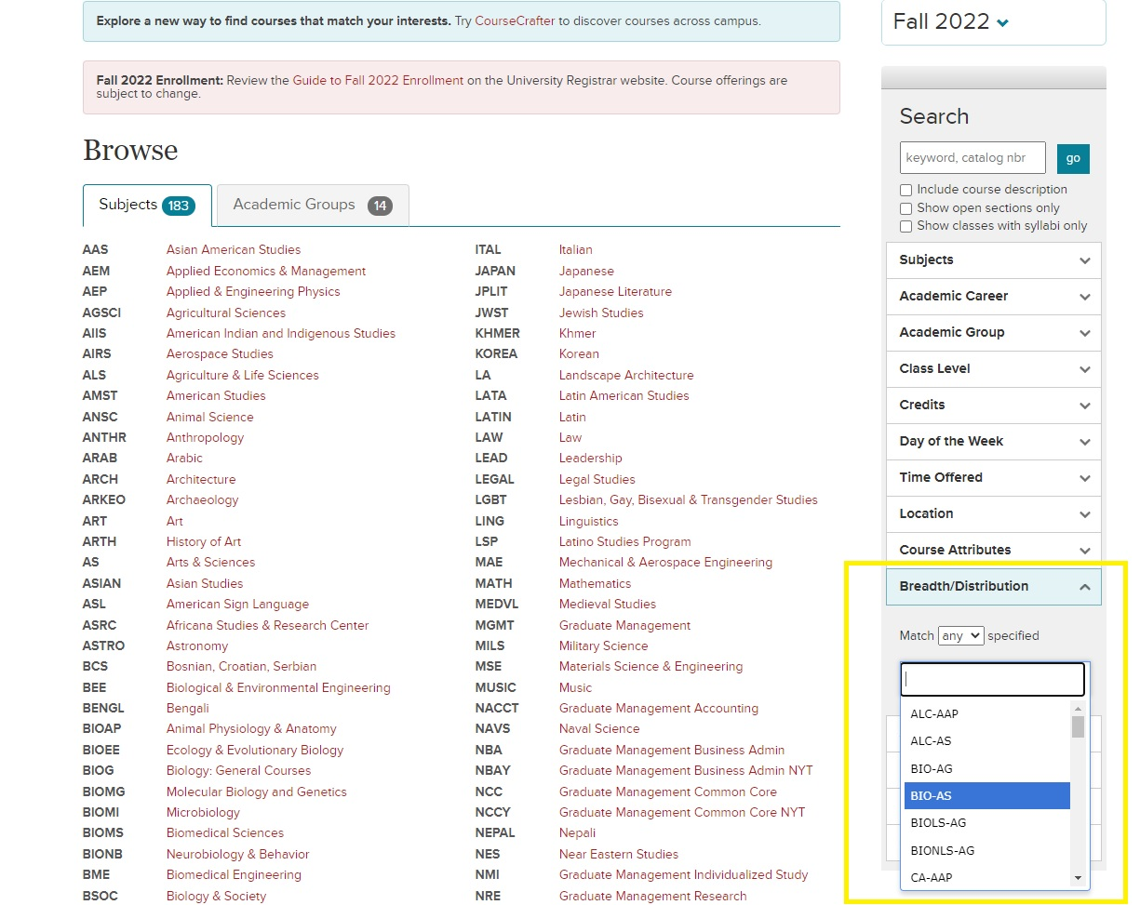
How To Search For Arts and Distribution Electives
College Distribution Requirement Codes can be found on Courses of Study
Search the Class Roster for classes that fulfill particular Distribution Categories
Cornell Nolan School of Hotel Administration 21
Notes:
Delete this slide before completing your presentation

Slide 22
Nolan School Classes that Meet Additional Distribution Electives
HADM 4300 Introduction to Wines (ALC-HA)
HADM 4380 Seminar in Culture and Cuisine (ALC-HA, GLC-HA)
HADM 4375 Intro to Fermented Grains, Sake, and Cider (ALC-HA)
HADM 4310 Food & Wine Pairing: Principles and Promotion (ALC-HA)
HADM 4315 Nonprofit Social Enterprise & Food Justice (GLC-HA, SCD-HA)
HADM 4300 Digital Platforms (SSC-HA)
HADM 3610 Communication for Entrepreneurs (SSC-HA)
HADM 4650 Advanced Communication Practicum in Public Speaking for Hospitality Leaders (SSC-HA)
HADM 4320 Contemporary Healthy Food (SSC-HA)
HADM 4620 Intercultural Communication for Business (GLC-HA, SSC-HA)
HADM 3960 Leadership, Diversity, & Inclusion in the Hospitality Industry (SCD-HA)
Cornell Nolan School of Hotel Administration 22
Notes:
Delete this slide before completing your presentation

Slide 23
Ethics Course
The ethics course requirement is intended to prepare students to think critically and knowledgeably about what is (or should be) considered right or wrong, good or bad, virtue or vice within their personal, professional, and/or public lives.
Approved Courses:
  AEM 2030: Sports as Society
  AEM 3205: Ethics in Business and Organizations
  BSOC 2061: Ethics & the Environment
  COMM 4300: Ethics in New Media, Technology, and Communication
  CRP 3011: Ethics, Development, and Globalization
  ECE 2750: Robot Ethic
  ILRLR 4820: Ethics at Work
  INFO 4301: Ethics in New Media
  INFO 1200: Information Ethics, Law, and Policy
  PHIL 1450: Contemporary Moral Issues
  PHIL 2410: Ethics
  PHIL 3231: Kant’s Ethics
  PHIL 1440: Ethics of Eating
If you find a class that you believe meets the standards for the Ethics requirement that is not included on the above list, please email the class description to the Nolan School Registrar at ha-registrar@cornell.edu for review.
Cornell Nolan School of Hotel Administration 23
Notes:
Delete this slide before completing your presentation

Slide 24
Diversity and Inclusion Course
The diversity course requirement is intended to provide students with an opportunity to explore the challenges/opportunities to an organization or community stemming from issues related to power, privilege, access, and equity.
Currently Approved Courses
  AEM 2015: The Business Case for Diversity and Inclusion
  AEM 3015: Developing Racial Equity in Organizations
  AMST 1104: Race and Ethnicity in the United States: Social Constructs Real World Consequences
  AMST 2505/FGSS 2501: Playing out Difference: History and Identity in Sports Film
  ANTHR 2470: Island and Gender
  ANTHR 3487: Racial Capitalism
  ASIAN 2230/CAPS 2230: Introduction to China: Outsiders in History
  EDUC 2610: Intergroup Dialogue
  FGSS 2010: Introduction to Feminist, Gender, and Sexuality Studies
  FGSS 2290: Introduction to Lesbian, Gay, Bisexual, and Transgender Studies
  FGSS 2501: Playing out Difference: History and Identity in Sports Film
  FGSS 2532: Judaism and Gender
  HADM 3960: Seminar in Leadership, Diversity, and Inclusion
  ILRHR 3640: Diversity & Inclusion
  ILRHR 4657: Workplace Disability Inclusion: Innovations and Initiatives (Autism at Work)
  ILRID 2510: Foundations of Diversity Dynamics
  ILRLR 1200: Introduction to Disability Studies
  NTRES 2000: Environmental Justice
  PAM 2208: Social Inequality
  PHIL 1650: Philosophy of Race
  PHIL 3525: Existentialism in Black
  SOC 2070: Social Problems in the United States
If you find a class that you believe meets the standards for the D&I requirement that is not included on the above list, please email the class description to the Nolan School Registrar at ha-registrar@cornell.edu for review.
Cornell Nolan School of Hotel Administration 24
Notes:
Delete this slide before completing your presentation

Slide 25
Free Electives
8 credit hours required
These credits may be taken for a letter grade OR pass/fail (S/U)
Students can explore any type of academic course to fulfill this requirement at any of Cornell's colleges/schools in or out of the SC Johnson College of Business.
Both HADM 1199 – Hotelie Launchpad (1 cr.) and HADM 1910 - Distinguished Lectures in Hospitality Management (1 cr.) count toward Free Electives
Cornell Nolan School of Hotel Administration 25
Notes:
Delete this slide before completing your presentation

Slide 26
Non-Academic Graduation Requirements
Physical Education (PE) - 2 courses
University Swim Test
800 Hours Practice Credit
Cornell Nolan School of Hotel Administration 26
Notes:
Delete this slide before completing your presentation

Slide 27
More About The Swim Test & Physical Education
Physical Education (PE): Taking 2 PE courses is a graduation requirement
  The credits DO NOT count toward the 120 academic credits required to graduate.
  Registration for PE classes is done online via Student Center.
Cornell Swim Test: Students must take their swim test when offered to meet graduation requirements. The swim test is typically taken during Orientation.
  Check the Physical Education website for Swim Test Dates & Times
Cornell Nolan School of Hotel Administration 27
Notes:
Delete this slide before completing your presentation

Slide 28
Practice Credit
The purpose of Practice Credit is to expose students to a variety of practical work experiences in industries they have a career interest in. This experience enhances the overall business education you receive at the Nolan School of Hotel Administration.
  Students must complete 800 hours/2 units of Practice Credits to meet graduation requirements.
    Experiences from high school or the summer prior to your first semester do not count toward Practice Credit
    Transfer students are eligible to receive up to 1 unit/400 hours of Practice Credit for work done during their time spent at their previous institution
    Students can only submit a maximum of 1 unit/400 hours of Practice Credit per experience.
  To receive 2 units of practice credit from the same organization, the nature of each job must be significantly different and pre-approved by the OSS Practice Credit Team.
For more information, please visit the Practice Credit webpage
Cornell Nolan School of Hotel Administration 30
Notes:
Delete this slide before completing your presentation

Slide 29
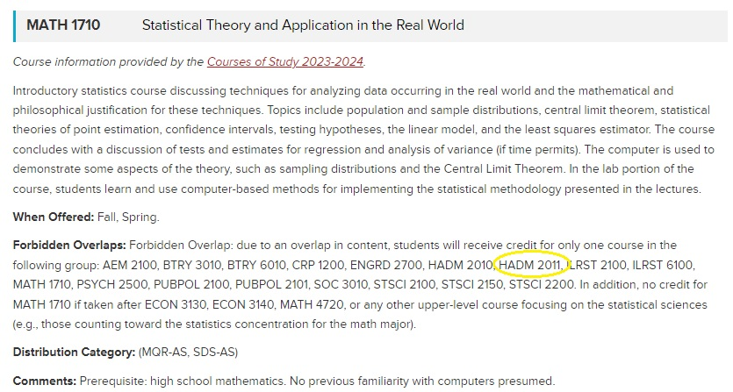
Forbidden Overlaps
Nolan students are not permitted to take classes that are Forbidden Overlaps with any HADM Core: It is your responsibility to make sure you are not enrolling in a Forbidden Overlap course.
This will be listed in the course description on the class roster. Students will not receive credit for any class that is a Forbidden Overlap with a core course.
Cornell Nolan School of Hotel Administration 29
Notes:
Delete this slide before completing your presentation

Slide 30
Credit Limit
Cornell Nolan School of Hotel Administration 26
Notes:
Delete this slide before completing your presentation

Slide 31
Grading Options
Grading Options
  Letter Grade ONLY: A+ through D-, F
    A passing letter grade is a D- and above
    There is no option to change grade option to S/U, cannot be petitioned
  Student Option: Letter grade or S/U
    There are campus-wide deadlines to make changes to the grade option for applicable classes
    Grade cutoff for a ‘S’ is C-
  Pass/Fail Only: SX/UX
    This grade option cannot be changed to a letter grade
    Does not impact GPA
Review the 2023-2024 Key Academic Dates for deadlines to change grading options
Cornell Nolan School of Hotel Administration 27
Notes:
Delete this slide before completing your presentation

Slide 32
Key Takeaways from the 4 Year Planning Assignment
Core sequencing and pre-requisites
Read class descriptions carefully
  Be mindful of Forbidden Overlaps
  Make sure you are taking the correct core course for the “new curriculum”
Planning to study abroad
  Simplest way to plan for a semester abroad is to reserve 15 credits of Additional Distribution Electives
  Students must complete all 2000-level core before studying abroad
  Review NSHA Study Abroad website for all eligibility requirements
  Education Abroad – find specific programs, meet with an Education Abroad advisor
Use your resources!
  Launchpad & Degree Audit
  Resources for Students
  4 Year Planning Sheet
  Connect with an advisor!
Cornell Nolan School of Hotel Administration 27
Notes:
Delete this slide before completing your presentation

Slide 33
QUESTIONS?
Cornell Nolan School of Hotel Administration 33
Notes:
You should not have to make any edits to this slide.

Slide 34
Reminder: Pre-enrollment Virtual Advising Drop-Ins
Virtual 1:1 Pre-Enrollment Drop-In Advising Schedule
Monday October 30 – Thursday November 2
  10:00am – 12:00pm
  2:00pm – 4:00pm
Friday November 3
  10:00am – 12:00pm
  2:00pm – 3:00pm
Monday November 6 – Thursday November 9
  10:00am – 12:00pm
  2:00pm – 4:00pm
Friday November 10
  10:00am – 12:00pm
  2:00pm – 3:00pm
Drop-Ins are held via Zoom
Meeting ID: 946 8781 2347
Passcode: 624493
Drop-Ins are intended for quick discussions about your Spring 2024 enrollment, and are not intended for extended advising conversations.
Cornell Nolan School of Hotel Administration 34
Notes:
Delete this slide before completing your presentation

Slide 35
CONTACT OSS
Academic Advising*
ha-advising@cornell.edu
*You are not assigned an Academic Advisor. You can see any of us!
Nolan Registrar Team
ha-registrar@cornell.edu
Practice Credit
ha-practicecredit@cornell.edu
A PDF of this slideshow, as well as a recording of this presentation will be posted on Resources for Students webpage.
Cornell Nolan School of Hotel Administration 35
Notes:
Edit the text to reflect the resource or office you are highlighting
Use the first line to display the name of the resource or office
Use the second line to display the physical location, web address, and or email of that resource or office.
Delete any extra text

Slide 36
THANK YOU!
Notes:
You should not have to make any edits to this slide.

