Slide 1
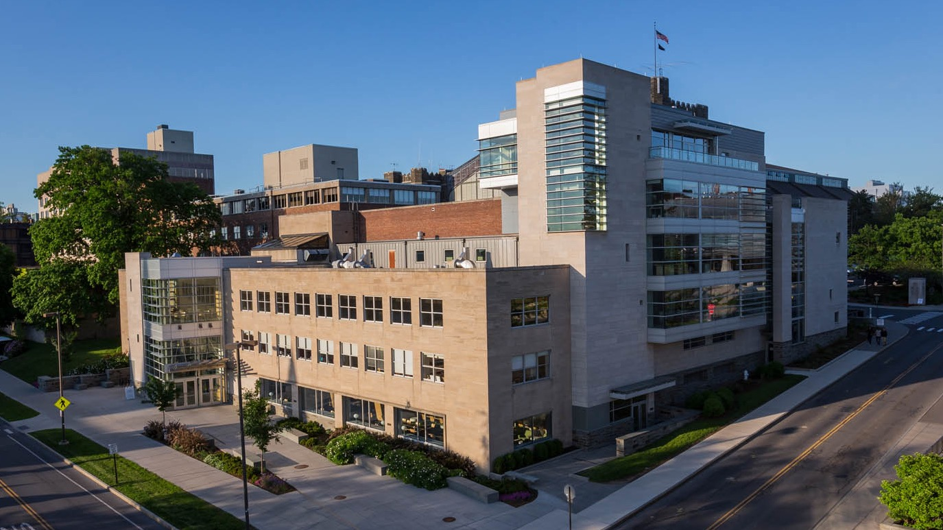
Curriculum Requirements
Bachelor of Science in Hotel Administration
Notes:
Insert any pre-title text in the text box at the top (ie. “Presented by…”)
Insert the presentation title in the second text box with the largest text
Insert the speaker’s name and/or the month, day and year of the presentation.
Delete any text boxes you didn’t use.
You are welcome to use the image that is already included. For instructions on how to change the image, view slide 6. In order to keep the transparent look, change the picture’s transparency to 75% in the ”Picture format” pane that should pop up on the right side of the screen.

Slide 2
Your Academic Plan
MY ACADEMIC PLAN
 | YEAR ONE |  |  |  |  |  | YEAR TWO |  |  |  |  |  | YEAR THREE |  |  |  |  |  | YEAR FOUR
 | FALL |  | SPRING |  | SUMMER |  | FALL |  | SPRING |  | SUMMER |  | FALL |  | SPRING |  | SUMMER |  | FALL |  | SPRING
 | HADM 1740 |  | HADM 1410 |  | ______ internship at ______ |  |  |  |  |  |  |  |  |  |  |  | ______ internship at ______
 | HADM 1210 |  | HADM 1150
 | HADM 1350 |  | HADM 1361
 | HADM 1650 |  | FWS
 | HADM 1199
 | HADM 1910
 | EXTRA-CURRICULARS |  |  |  |  |  | EXTRA-CURRICULARS |  |  |  |  |  | EXTRA-CURRICULARS |  |  |  |  |  | EXTRA-CURRICULARS
 |  |  |  |  | REMINDER: |  | All 2000 Core MUST be completed by the end of the junior year or prior to studying abroad (whichever comes first).
 |  |  |  |  |  |  | Study Abroad will NOT be approved for students with outstanding 2000-level core (i.e., not completed or currently enrolled in).
 |  |  |  |  |  |  | Students will be auto-enrolled into any outstanding 2000 core in the Spring of their Junior year.

Slide 3
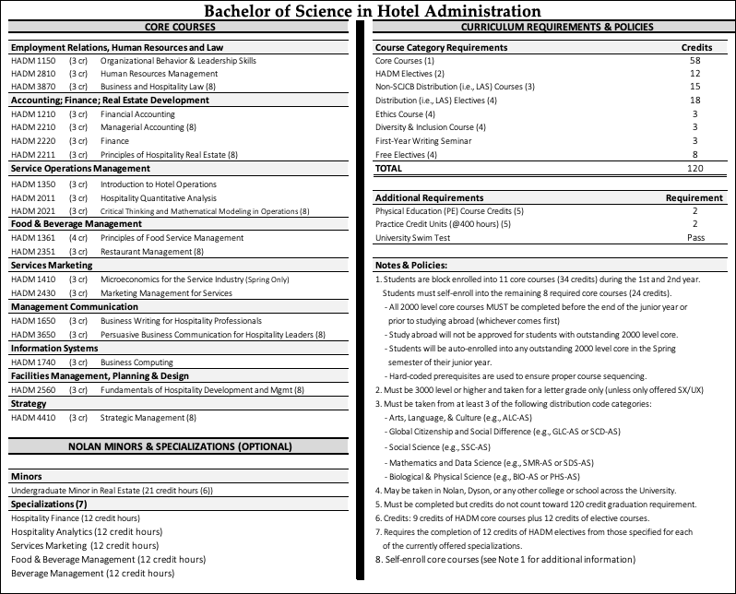
School of Hotel Administration 3
Notes:
Enter the topic title in the text box on the top.
Enter your short bulleted text
You are welcome to use the image that is already included. For instructions on how to change the image, view slide 6.
* When replacing an image the width will come in the same as the image on this page, however the height will match the original ratio of the photo. Use the crop tool to increase the height of the photo’s frame to the full height of the slide and then resize and reposition the photo within that frame.

Slide 4
Program Requirements
HADM CORE COURSES
(58 Credits)
Additional Requirements
CORE COURSES - APPLIED
(40 Credits)
CORE COURSES – DISTRIBUTIVE (LAS)
(18 Credits)
Practice Credit
(800 Hours)
HADM ELECTIVES
(Applied)
(12 Credits)
REQUIRED DISTRIBUTIVE (LAS) ELECTIVES
FWS (3 Credits)
Ethics (3 Credits)
Diversity (3 Credits)
Non-SCJCB Distributive (15 credits)
University P.E. Requirement
(2 Credits)
FREE ELECTIVES
(Applied or DR, HADM or other)
(8 Credits)
ADDITIONAL DISTRIBUTIVE ELECTIVES
(HADM or other)
(18 Credits)
University Swim Test Requirement
(recommended within 1st yr)
Nolan School of Hotel Administration 4
Notes:
Enter the title in the first text box
Fill in your bulleted text in the second text box.
*** USE THIS SLIDE SPARINGLY THROUGHOUT YOUR PRESENTATION***
Putting large bodies of text on your slides is not recommended.

Slide 5
Program Credit Summary

Slide 6
First Year Core Experience
Four Core Courses Each Semester – Blocked
Organizational Behavior (HADM 1150)
Financial Accounting (HADM 1210)
Intro to Hotel Operations (HADM 1350)
Principles of Food Service Management (HADM 1361)
Micro-Economics (HADM 1410)
Business Writing for Hospitality Professional (HADM 1650)
Business Computing (HADM 1740)
First Year Writing Seminar
Plus DDLS/Hotelie Launchpad (HADM 1910/1199) during fall semester

Slide 7
Second/Third Year Core Experience
Four Blocked Core Classes - Three in Fall, One in Spring
Hospitality Quantitative Analysis (HADM 2011) – taught mostly in the Fall
Finance (HADM 2220) – taught mostly in the Fall
Marketing Management for Services (HADM 2430)
Human Resource Management (HADM 2810)
Five Flex Core Classes – take in Second/Third Year
Critical Thinking and Mathematical Modeling (HADM 2021)
Managerial Accounting (HADM 2210)
Principles of Hospitality Real Estate (HADM 2221)
Restaurant Management (HADM 2351)
Fundamentals of Hospitality Development and Management (HADM 2560)
One blocked in Fall, the other in Spring.

Slide 8
Third/Fourth Year Core Experience
Third/Fourth Year
Persuasive Business Communication (HADM 3650)
Business and Hospitality Law (HADM 3870)
Strategic Management (HADM 4410)

Slide 9
Enrollment Sequencing Requirements/Restrictions
2000-level core classes MUST be completed by end of third year.
You must have completed (or be enrolled in) all required 2000-level core to be approved for study abroad.
You will be auto-enrolled in any outstanding 2000-level core in your second semester of your junior year.
Note: This may result in you being dropped from any non-core courses you self-enrolled into during pre-enroll.
May be exceptions for junior transfer students.
Hard-coded pre-requisites are used to ensure proper sequencing e.g.,
HADM 2220 must be completed BEFORE enrolling into HADM 2221
HADM 3650 must be completed BEFORE enrolling into HADM 4410
And more.

Slide 10
Nolan Minors & Specializations:
Undergraduate Minor in Real Estate
Specializations:
Hospitality Finance
Hospitality Analytics
Services Marketing
Food & Beverage Management
Beverage Management
Minors & Specializations are OPTIONAL. Students may declare any time after start of second semester sophomore year.
School of Hotel Administration 10

Slide 11
Hospitality Finance
Foundations (6 credits required)
HADM 4225 Hospitality Financial Strategy
HADM 3235 Intermediate Corporate Finance
Enrichments (6 credits required)
HADM 4770 Advanced Business Modeling
HADM 4250 Securitization and Structured Products
HADM 4270 Fixed Income Analysis
HADM 4290 Investment Analysis and Portfolio Management
HADM 4260 Advanced Corporate Finance
HADM 4240 Analysis of Financial Statements
School of Hotel Administration 11
Notes:
Enter the topic title in the text box on the top.
Enter your short bulleted text
You are welcome to use the image that is already included. For instructions on how to change the image, view slide 6.
* When replacing an image the width will come in the same as the image on this page, however the height will match the original ratio of the photo. Use the crop tool to increase the height of the photo’s frame to the full height of the slide and then resize and reposition the photo within that frame.

Slide 12
Hospitality Analytics
Foundations (6 credits required)
HADM 4760 Visual Basic for Applications
HADM 4050 Revenue Management
Enrichments (6 credits required)
HADM 4010 Data Driven Analytics
HADM 4070 Hospitality Operations and Consulting
HADM 4015 Operations Analysis and New Business Models
HADM 3740 Fundamentals of Database Management
HADM 4060 Restaurant Revenue Management
HADM 4470 Hospitality Distribution and Pricing
HADM 4490 Integrated Marketing Communications and New Media for Hospitality
School of Hotel Administration 12
Notes:
Enter the topic title in the text box on the top.
Enter your short bulleted text
You are welcome to use the image that is already included. For instructions on how to change the image, view slide 6.
* When replacing an image the width will come in the same as the image on this page, however the height will match the original ratio of the photo. Use the crop tool to increase the height of the photo’s frame to the full height of the slide and then resize and reposition the photo within that frame.

Slide 13
Services Marketing
Foundations (6 credits required)
HADM 3430 Marketing Research
HADM 3470 Consumer Behavior
Enrichments (6 credits required)
HADM 3450 Services Experience Management and Marketing
HADM 4050 Yield Management
HADM 4425 Introduction to the Global Leisure Cruise Industry
HADM 4430 Wine Marketing
HADM 4480 Brand Management
HADM 4435 Luxury Marketing
HADM 4490 Integrated Marketing Communications and New Media for Hospitality
School of Hotel Administration 13
Notes:
Enter the topic title in the text box on the top.
Enter your short bulleted text
You are welcome to use the image that is already included. For instructions on how to change the image, view slide 6.
* When replacing an image the width will come in the same as the image on this page, however the height will match the original ratio of the photo. Use the crop tool to increase the height of the photo’s frame to the full height of the slide and then resize and reposition the photo within that frame.

Slide 14
Food & Beverage Mgmt.
Foundations (6 credits required)
HADM 4350 Selection, Procurement, and Supply Management
HADM 4315 Nonprofit Social Enterprise and Food Justice
Enrichments (6 credits required)
HADM 3360 Tactics and Strategies for Restaurant Management
HADM 6310 Environmental, Social, & Governance Strategy in the Food & Beverage Industry
HADM 4325 Product Development
HADM 4340 Catering & Special Events Management
HADM 4510 Restaurant Development
HADM 4530 Foodservice Facilities Design
HADM 4301 Restaurant Entrepreneurship
HADM 4060 Restaurant Revenue Management
School of Hotel Administration 14
Notes:
Enter the topic title in the text box on the top.
Enter your short bulleted text
You are welcome to use the image that is already included. For instructions on how to change the image, view slide 6.
* When replacing an image the width will come in the same as the image on this page, however the height will match the original ratio of the photo. Use the crop tool to increase the height of the photo’s frame to the full height of the slide and then resize and reposition the photo within that frame.

Slide 15
Beverage Management
Foundations (5 credits required)
HADM 4300 Introduction to Wines (2 credits)
HADM 4360 Beverage Management
Enrichments (7 credits required)
HADM 4350 Selection, Procurement, and Supply Management
HADM 4310 Wine & Food Pairing Principles
HADM 4375 Seminar in Quality Brewing and Fine Beer
HADM 4430 Wine Marketing
HADM 3360 Tactics and Strategies for Restaurant Mgmt.
HADM 4325 Product Development
HADM 4510 Restaurant Development
HADM 4530 Foodservice Facilities Design
HADM 4301 Restaurant Entrepreneurship
HADM 4060 Restaurant Revenue Management
School of Hotel Administration 15
Notes:
Enter the topic title in the text box on the top.
Enter your short bulleted text
You are welcome to use the image that is already included. For instructions on how to change the image, view slide 6.
* When replacing an image the width will come in the same as the image on this page, however the height will match the original ratio of the photo. Use the crop tool to increase the height of the photo’s frame to the full height of the slide and then resize and reposition the photo within that frame.

Slide 16
C: Real Estate Minor
(as specialization for NSHA students)
Foundations (3 credits required)
HADM 4230: Real Estate Finance OR
HADM 4280: Real Estate Finance and Investments
Enrichments (Min. 3 credits; pick one or more)
HADM 4205: Introduction to Real Estate Financial Modeling
HADM 4250: Securitization and Structured Financial Products
HADM 4255: Real Estate Development
HADM 4270: Investment in Real Estate Securities and Funds
HADM 4510: Restaurant Development
HADM 4570: Project Management for Hospitality Real Estate Development
HADM 4580: Advanced Project Management
HADM 6520: Hospitality Asset Management
HADM 6230: Statistical Analysis of Real Estate Data
HADM 6231: Urban Theory and Real Market Analysis
Note: NSHA students MUST meet GPA requirement to earn the minor.
School of Hotel Administration 16

Slide 17
C: Real Estate Minor Con’t.
HADM Complementary Skills Courses (minimum 3 credits, pick one or more)
HADM 3510: Hospitality Facilities Design
HADM 4110: Negotiations in the Hospitality Industry
HADM 4260: Advanced Corporate Finance
HADM 4270: Fixed Income Analysis
HADM 4290: Investment Analysis and Portfolio Management
HADM 4530: Foodservice Facilities Design
HADM 4550: Introduction to Sustainable Hospitality Principles
HADM 4760: Visual Basic for Applications: End-user Programming
HADM 4770: Advanced Business Modeling
HADM 4870: Real Estate Law
HADM 6240: Analysis of Financial Statements
HADM 6500: Sustainable Development
Note: NSHA students MUST meet GPA requirement to earn the minor.
School of Hotel Administration 17

Slide 18
C: Real Estate Minor Con’t.
Non-HADM Complementary Skills Courses
AEM 2190: Introduction to Applied Portfolio Management
AEM 4110: Introduction to Econometrics
AEM 4210: Derivatives and Risk Management
AEM 4260: Fixed-Income Securities
AEM 4280: Valuation of Capital Investment
AEM 4500: Resource Economics (also ECON 4810)
AEM 4570: Corporate Finance
AEM 4670: Investments
CEE 5950: Construction Planning and Operations
CRP 3270/6270: Regional Economic Impact Analysis
CRP 3430/6430: Affordable Housing Policy and Programs
CRP 3840/5840: Green Cities (also LA 4950)
CRP 3850: Special Topics in Planning
CRP 4040/5040 – Urban Economics
CRP 4080: Introduction to Geographic Information Systems (GIS)
CRP 4590/5590 :Legal Aspects of Land Use Planning
CRP 5190: Urban Theory and Spatial Development
CRP 5320 &5321: Real Estate Development Process
CRP 5330: Real Estate Marketing and Management
CRP 5530: Concepts and Methods of Land Use Planning
CRP 5560: Creating the Built Environment
CRP 6560: Real Estate Transactions and Deal Structuring
Note: Non-HADM Complimentary Skills courses will count toward the Minor but NOT toward HADM electives.
School of Hotel Administration 18

Slide 19
C: Real Estate Minor Con’t.
Non-HADM Complementary Skills Courses
CRP 6580: Residential and Commercial Development
CRP 6590: Special Topics: Urban Development Planning
CRP 6593: Special Topics: Introduction to Green Real Estate
DEA 3530: Planning and Managing the Workplace
ECON 3120 Applied Econometrics
ECON 3410 Econometrics
ECON 4240 Financial Economics, Derivatives and Risk Management
ILRLR 6011 Negotiation: Theory and Practice
NBA 4120 Equity Investment Research and Analysis
NBA 5060 Financial Statement Analysis
NBA 5061 Comprehensive Financial Statement Analysis
NBA 5110 Financial Modeling
NBA 5420 Investment and Portfolio Management
NBA 6660 Negotiations
NBA 6730 Derivative Securities Part 1
ORIE 5582 Monte Carlo Methods in Financial Engineering
ORIE 5600 Financial Engineering with Stochastic Calculus I
ORIE 5610 Financial Engineering with Stochastic Calculus II
ORIE 5630 Computational Methods in Finance
PAM 3100 Multiple Regression Analysis
PAM 3250 Neighborhoods, Housing and Urban Policy
Note: Non-HADM Complimentary Skills courses will count toward the Minor but NOT toward HADM electives.
School of Hotel Administration 19

Slide 20
Enrollment Requirements/Advising/ Communication
OSS/Student Handbook/School Website:
Degree Audit
Core curriculum/course requirements
Course sequencing requirements/policies
Sample schedules/timelines
Hotelie Launchpad:
Academic/career paths panel (of faculty from across disciplines)
Career planning/internships timeline (w/career services)
Cornell University:
Course Roster
Courses of Study

Slide 21
Your Academic Plan
QUESTIONS?
MY ACADEMIC PLAN
 | YEAR ONE |  |  |  |  |  | YEAR TWO |  |  |  |  |  | YEAR THREE |  |  |  |  |  | YEAR FOUR
 | FALL |  | SPRING |  | SUMMER |  | FALL |  | SPRING |  | SUMMER |  | FALL |  | SPRING |  | SUMMER |  | FALL |  | SPRING
 | HADM 1740 |  | HADM 1410 |  | ______ internship at ______ |  |  |  |  |  |  |  |  |  |  |  | ______ internship at ______
 | HADM 1210 |  | HADM 1150
 | HADM 1350 |  | HADM 1361
 | HADM 1650 |  | FWS
 | HADM 1199
 | HADM 1910
 | EXTRA-CURRICULARS |  |  |  |  |  | EXTRA-CURRICULARS |  |  |  |  |  | EXTRA-CURRICULARS |  |  |  |  |  | EXTRA-CURRICULARS
 |  |  |  |  | REMINDER: |  | All 2000 Core MUST be completed by the end of the junior year or prior to studying abroad (whichever comes first).
 |  |  |  |  |  |  | Study Abroad will NOT be approved for students with outstanding 2000-level core (i.e., not completed or currently enrolled in).
 |  |  |  |  |  |  | Students will be auto-enrolled into any outstanding 2000 core in the Spring of their Junior year.

Slide 22
Sequencing Examples
CURRICULUM SEQUENCE EXAMPLE: STUDY ABROAD FOCUS
 | YEAR ONE |  |  |  |  |  | YEAR TWO |  |  |  |  |  | YEAR THREE |  |  |  |  |  | YEAR FOUR
 | FALL |  | SPRING |  |  |  | FALL |  | SPRING |  |  |  | FALL |  | SPRING |  |  |  | FALL |  | SPRING
BLOCK ONE | HADM 1740 |  | HADM 1410* |  | Practice Credit |  | HADM 2011* |  | HADM 2810 |  | Practice Credit |  | HADM 2021* | 2000 Core Auto-Enroll | Dist.* |  | Practice Credit |  | 3000 Core* |  | HADM 4410
 | HADM 1210 |  | HADM 1150* |  |  |  | HADM 2220 |  | HADM 2221 |  |  |  | 3000 Core |  | Dist.* |  |  |  | Spec. Elec. |  | Spec. Elec.
 | HADM 1350 |  | HADM 1361 |  |  |  | HADM 2430 |  | HADM 2351 |  |  |  | Spec. Elec. |  | Dist. (Arts)* |  |  |  | Spec. Elec. |  | HADM Elec.
 | HADM 1650* |  | FWS* |  |  |  | HADM 2210 |  | HADM 2560 |  |  |  | Dist.* |  | Dist. (Arts)* |  |  |  | HADM Elec. |  | Dist.*
 | 1199/1910 |  | Dist. (DEI)* |  |  |  | Dist. (Ethics)* |  | Dist. (Arts)* |  |  |  | Dist.* |  | Dist. (Arts)* |  |  |  | Dist.* |  | Dist. (Arts)*
 | Swim |  | PE
CURRICULUM SEQUENCE EXAMPLE: REAL ESTATE FOCUS
 | YEAR ONE |  |  |  |  |  | YEAR TWO |  |  |  |  |  | YEAR THREE |  |  |  |  |  | YEAR FOUR
 | FALL |  | SPRING |  |  |  | FALL |  | SPRING |  |  |  | FALL |  | SPRING |  |  |  | FALL |  | SPRING
BLOCK ONE | HADM 1740 |  | HADM 1410* |  | Practice Credit |  | HADM 2011* |  | HADM 2810 |  | Practice Credit |  | HADM 2021* | 2000 Core Auto-Enroll | HADM 2351 |  | Practice Credit |  | HADM 3870 |  | HADM 4410
 | HADM 1210 |  | HADM 1150* |  |  |  | HADM 2220 |  | HADM 2221 |  |  |  | HADM 4205 |  | HADM 3650* |  |  |  | HADM 4271 |  | HADM 6230/31
 | HADM 1350 |  | HADM 1361 |  |  |  | HADM 2430 |  | HADM 2560 |  |  |  | HADM 4230 |  | HADM 4255 |  |  |  | HADM 6520 |  | HADM 4620*
 | HADM 1650* |  | FWS* |  |  |  | HADM 2210 |  | PAM 3250* |  |  |  | ECON 3120* |  | ECON 3855* |  |  |  | HADM 4375* |  | HADM 4500*
 | 1199/1910 |  | Dist. (DEI)* |  |  |  | Dist. (Ethics)* |  | Dist. (Arts)* |  |  |  | Dist. (Arts)* |  | Dist. (Arts)* |  |  |  | Dist. (Arts)* |  | Dist. (Arts)*
 | Swim |  | PE

Slide 23
Sequencing Examples
CURRICULUM SEQUENCE EXAMPLE: FINANCE FOCUS
 | YEAR ONE |  |  |  |  |  | YEAR TWO |  |  |  |  |  | YEAR THREE |  |  |  |  |  | YEAR FOUR
 | FALL |  | SPRING |  |  |  | FALL |  | SPRING |  |  |  | FALL |  | SPRING |  |  |  | FALL |  | SPRING
BLOCK ONE | HADM 1740 |  | HADM 1410* |  | Practice Credit |  | HADM 2011* |  | HADM 2810 |  | Practice Credit |  | HADM 2021* | 2000 Core Auto-Enroll | HADM 2351 |  | Practice Credit |  | HADM 3650* |  | HADM 4410
 | HADM 1210 |  | HADM 1150* |  |  |  | HADM 2220 |  | HADM 2221 |  |  |  | HADM 3870 |  | HADM 4240 |  |  |  | HADM 4270 |  | HADM 4770
 | HADM 1350 |  | HADM 1361 |  |  |  | HADM 2430 |  | HADM 2560 |  |  |  | HADM 4225 |  | Dist.* |  |  |  | HADM 4250 |  | Dist.*
 | HADM 1650* |  | FWS* |  |  |  | HADM 2210 |  | HADM 3235 |  |  |  | HADM 4380 |  | Dist.* |  |  |  | Dist.* |  | Dist.*
 | 1199/1910 |  | Dist. (DEI)* |  |  |  | Dist. (Ethics)* |  | Dist. (Arts)* |  |  |  | Dist. (Arts)* |  | Dist. (Arts)* |  |  |  | Dist. (Arts)* |  | Dist. (Arts)*
 | Swim |  | PE
CURRICULUM SEQUENCE EXAMPLE: FOOD & BEVERAGE FOCUS
 | YEAR ONE |  |  |  |  |  | YEAR TWO |  |  |  |  |  | YEAR THREE |  |  |  |  |  | YEAR FOUR
 | FALL |  | SPRING |  |  |  | FALL |  | SPRING |  |  |  | FALL |  | SPRING |  |  |  | FALL |  | SPRING
BLOCK ONE | HADM 1740 |  | HADM 1410* |  | Practice Credit |  | HADM 2011* |  | HADM 2810 |  | Practice Credit |  | HADM 2021* | 2000 Core Auto-Enroll | HADM 3650* |  | Practice Credit |  | HADM 4410 |  | HADM 4530
 | HADM 1210 |  | HADM 1150* |  |  |  | HADM 2220 |  | HADM 2221 |  |  |  | HADM 3870 |  | HADM 4350 |  |  |  | HADM 4510 |  | HADM 4375*
 | HADM 1350 |  | HADM 1361 |  |  |  | HADM 2430 |  | HADM 2351 |  |  |  | HADM 4360 |  | HADM 4255 |  |  |  | HADM 6520 |  | Dist.*
 | HADM 1650* |  | FWS* |  |  |  | HADM 2210 |  | HADM 2560 |  |  |  | HADM 4380 |  | HADM 4315 |  |  |  | Dist.* |  | Dist.*
 | 1199/1910 |  | Dist. (DEI)* |  |  |  | Dist. (Ethics)* |  | Dist. (Arts)* |  |  |  | Dist. (Arts)* |  | Dist. (Arts)* |  |  |  | Dist. (Arts)* |  | Dist. (Arts)*
 | Swim |  | PE

Slide 24
Sequencing Examples
CURRICULUM SEQUENCE EXAMPLE: HOSPITALITY ANALYTICS & DS MINOR FOCUS
 | YEAR ONE |  |  |  |  |  | YEAR TWO |  |  |  |  |  | YEAR THREE |  |  |  |  |  | YEAR FOUR
 | FALL |  | SPRING |  |  |  | FALL |  | SPRING |  |  |  | FALL |  | SPRING |  |  |  | FALL |  | SPRING
BLOCK ONE | HADM 1740 |  | HADM 1410* |  | Practice Credit |  | HADM 2011* |  | HADM 2810 |  | Practice Credit |  | HADM 2221 | 2000 Core Auto-Enroll | HADM 2021* |  | Practice Credit |  | HADM 3650* |  | HADM 4410
 | HADM 1210 |  | HADM 1150* |  |  |  | HADM 2220 |  | HADM 2351 |  |  |  | HADM 3870 |  | HADM 4050* |  |  |  | HADM 4490 |  | HADM 4010*
 | HADM 1350 |  | HADM 1361 |  |  |  | HADM 2430 |  | HADM 2560 |  |  |  | HADM 4760* |  | Dist.* |  |  |  | HADM 3235 |  | HADM 4430
 | HADM 1650* |  | FWS* |  |  |  | HADM 2210 |  | MATH 4720* |  |  |  | HADM 3740* |  | Dist.* |  |  |  | ECON 3140* |  | Dist.*
 | 1199/1910 |  | Dist. (DEI)* |  |  |  | Dist.* |  | INFO 2950* |  |  |  | Dist. (Arts)* |  | INFO 4145* |  |  |  | Dist. (Arts)* |  | Dist. (Arts)*
 | Swim |  | PE
CURRICULUM SEQUENCE EXAMPLE: SERVICES MARKETING FOCUS
 | YEAR ONE |  |  |  |  |  | YEAR TWO |  |  |  |  |  | YEAR THREE |  |  |  |  |  | YEAR FOUR
 | FALL |  | SPRING |  |  |  | FALL |  | SPRING |  |  |  | FALL |  | SPRING |  |  |  | FALL |  | SPRING
BLOCK ONE | HADM 1740 |  | HADM 1410* |  | Practice Credit |  | HADM 2011* |  | HADM 2810 |  | Practice Credit |  | HADM 2221 | 2000 Core Auto-Enroll | HADM 2021* |  | Practice Credit |  | HADM 3650* |  | HADM 4410
 | HADM 1210 |  | HADM 1150* |  |  |  | HADM 2220 |  | HADM 2351 |  |  |  | HADM 3870 |  | HADM 4050* |  |  |  | HADM 4490 |  | HADM 4010*
 | HADM 1350 |  | HADM 1361 |  |  |  | HADM 2430 |  | HADM 2560 |  |  |  | HADM 4760* |  | Dist.* |  |  |  | HADM 3235 |  | HADM 4430
 | HADM 1650* |  | FWS* |  |  |  | HADM 2210 |  | MATH 4720* |  |  |  | HADM 3740* |  | Dist.* |  |  |  | ECON 3140* |  | Dist.*
 | 1199/1910 |  | Dist. (DEI)* |  |  |  | Dist.* |  | INFO 2950* |  |  |  | Dist. (Arts)* |  | INFO 4145* |  |  |  | Dist. (Arts)* |  | Dist. (Arts)*
 | Swim |  | PE

