Slide 1
Fall 2023 Enrollment Information for Students who Matriculated in Fall 2022 or Later
Notes:
Insert any pre-title text in the text box at the top (ie. “Presented by…”)
Insert the presentation title in the second text box with the largest text
Insert the speaker’s name and/or the month, day and year of the presentation.
Delete any text boxes you didn’t use.
You are welcome to use the image that is already included. For instructions on how to change the image, view slide 6. In order to keep the transparent look, change the picture’s transparency to 75% in the ”Picture format” pane that should pop up on the right side of the screen.

Slide 2
Getting Answers
STEP 1
USE YOUR RESOURCES
STEP 2
ATTEND VIRTUAL 1:1 ADVISING DROP-INS
STEP 3
E-MAIL THE ADVISING TEAM
If you have questions, please follow this process!
MAKE AN APPOINTMENT
Student Launchpad
Degree Audit
Student Handbook
Enrollment FAQs
Opportunity to meet with an advisor individually without an appointment!
Offered via Zoom
Students are seen on ‘first come first served’ basis
Individual 30 minute scheduled appointments are intended for students who wish to discuss long term goals and want to do complex planning related to those goals.
Please do not make an appointment for a quick question that could be answered in drop-ins or via email
STEP 4
ha-advising@cornell.edu
Expect a response time of up to 3 business days
Notes:
Delete this slide before completing your presentation

Slide 3
Use Your Resources!
Student LaunchPad
Student Essentials
Links you to your Student Center to view your pre-enrolled core schedule and enroll in additional courses.
NSHA Resources for Students
Pre-Enrollment FAQs
These slides!
Core Swap Request Form & Instructions
4 Year Planning Sheet
Classes and Enrollment FAQ
Step by step instructions on how to add a class
Guide to Fall 2023 Enrollment
Cornell Nolan School of Hotel Administration 3
Notes:
Delete this slide before completing your presentation

Slide 4
Pre-Enrollment Dates
May 1 at 7:30am – May 3 until 11:59pm: Seniors and rising Seniors
May 2 at 7:30am – May 4 until 11:59pm: Juniors and rising Juniors
May 3 at 7:30am – May 5 until 11:59pm: Sophomores and continuing First Years
Review the 2022-2023 Key Academic Dates for more important dates and deadlines!
Cornell Nolan School of Hotel Administration 4
Notes:
Delete this slide before completing your presentation

Slide 5
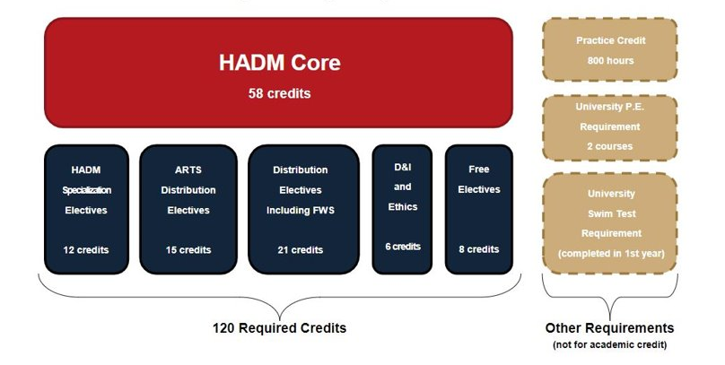
Undergraduate Degree Requirements
Cornell Nolan School of Hotel Administration 5
Notes:
Delete this slide before completing your presentation

Slide 6
Hotel Administration (HADM) Core
1000-Level
HADM 1150: Org. Behavior & Leadership Skills
HADM 1210: Financial Accounting
HADM 1350: Intro. to Hotel Operations
HADM 1361: Principles of F&B Operations Mgmnt.
HADM 1410: Microeconomics
HADM 1650: Business Writing
HADM 1740: Business Computing
2000-Level
HADM 2011: Hospitality Quant. Analysis
HADM 2021: Critical Thinking & Mathematical Modeling in Operations
HADM 2210: Managerial Accounting
HADM 2220: Finance
HADM 2221: Principles of Hospitality Real Estate
HADM 2351: Restaurant Management
HADM 2430: Marketing Mgmnt. For Services
HADM 2560: Fundamentals Of Hospitality Development & Mgmnt.
HADM 2810: Human Resources Mgmnt.
3000-Level
HADM 3650: Persuasive Business Communication for Hospitality Leaders
HADM 3870: Business & Hospitality Law
4000-Level
HADM 4410: Strategic Mgmnt.
Students are enrolled into all 1000-level core by the Nolan School Registrar team in ‘Core Blocks’
Cornell Nolan School of Hotel Administration 6
Notes:
Delete this slide before completing your presentation

Slide 7
2000-Level HADM Core – UPDATED CORE SEQUENCING
PRE-ENROLLED CORE | SELF-ENROLL CORE
HADM 2011 – Hospitality Quantitative Analysis (pre-req: HADM 1740) | HADM 2021 – Critical Thinking and Mathematical Modeling (pre-req: HADM 2011)
HADM 2220 – Finance (pre-req: HADM 1210) | HADM 2210 – Managerial Accounting (pre-req: HADM 1210)
HADM 2430- Marketing Management for Services (Recommended pre-req: HADM 1410) | HADM 2221 – Principles of Hospitality Real Estate (pre-req: HADM 1210 & HADM 2220)
HADM 2810 – Human Resources Management (pre-req: HADM 1150) | HADM 2351 – Restaurant Management (pre-req: HADM 1361)
 | HADM 2560 – Fundamentals of Hospitality Development Management (Recommended pre-req: HADM 1350)
Cornell Nolan School of Hotel Administration 7
Notes:
Delete this slide before completing your presentation

Slide 8
2000-Level HADM Core – UPDATED CORE SEQUENCING
For Fall 2023, all students under the new curriculum will be pre-enrolled in the following core classes by the Nolan School Registrar*:
HADM 2011 Hospitality Quantitative Analysis (unless already completed)
HADM 2220 Finance
HADM 2810 Human Resources Management OR HADM 2430 Marketing Management for Services
In Spring 2024, students will be enrolled by the Nolan School Registrar in whichever of these two courses they do not complete in Fall 2023
*Internal and External Transfer Students will continue to be enrolled in four (4) ‘pre-enrolled’ core courses per semester until they are completed.
Students now have the autonomy to decide when they want to enroll in the remaining Self-Enroll 2000-level core (once they have completed the pre-requisites)
All 2000-level core must be completed by the end of junior year. Students must have completed (or be enrolled in) all 2000-level core to be approved to study abroad.
Cornell Nolan School of Hotel Administration 8
Notes:
Delete this slide before completing your presentation

Slide 9
3000 and 4000-level HADM Core
Self- Enroll (Student enroll themselves once they have completed the pre-requisites)
HADM 3650 Persuasive Business Communication – Pre-requisite: HADM 1650
HADM 3870 Business and Hospitality Law – Pre-requisite: HADM 2810
HADM 4410 Strategic Management – Pre-requisites: HADM 2021, HADM 2211, HADM 2351, HADM 2430, HADM 2560, HADM 2810, HADM 3650
Cornell Nolan School of Hotel Administration 9
Notes:
Delete this slide before completing your presentation

Slide 10
Holds
The Nolan School Registrar has enrolled all students into their pre-enrolled 1000 and 2000-level core courses for Fall 2023.
If you log in to your Student Center and do not see that you have been enrolled in classes, this likely means that you have a HOLD on your account. It is imperative that you take steps to release your hold(s) as soon as possible.
To check your holds, first sign into your Student Center
Next, check for ‘Holds’ on the right side of the screen
Click on ‘Details’ to read more about your hold(s), and instructions on how to get them removed
Take the appropriate steps to get hold(s) removed. This may include contacting the department the hold was placed by
E-mail ha-registrar@cornell.edu to announce that your holds have been removed
The registrar team will NOT be able to enroll you into your 1000 and 2000 level core classes while a hold is in place. So they can move forward with enrolling you in lower-level core once a hold is cleared, it is the student’s responsibility to notify them.
Cornell Nolan School of Hotel Administration 10
Notes:
Delete this slide before completing your presentation

Slide 11
Core Swap Requests
The electronic core section swap process allows students enrolled in 1000-level and 2000-level pre-enrolled HADM core courses to request to swap from one course section into another section of the same course (example: request to swap from HADM 1210 Lecture 001 to HADM 1210 Lecture 002)
Swap Requests are not guaranteed, but the registrar team will try to accommodate as many swaps as possible
Swap requests will be accepted until August 24, 2023 using the Swap Request Form
Please do not submit duplicate requests.
Connect with our registrar team at ha-registrar@cornell.edu for any clarifying questions related to swap requests or to cancel requests
Cornell Nolan School of Hotel Administration 11
Notes:
Delete this slide before completing your presentation

Slide 12
HADM Specialization Electives
12 credits required
These credits must be completed as a letter grade unless offered SX/UX
Students can declare their specialization as early as the first semester of their second year. All students will be able to modify their specialization selection up until the University Add deadline date of the first semester of their senior year.
Cornell Nolan School of Hotel Administration 12
Notes:
Delete this slide before completing your presentation

Slide 13
Distribution Requirements
42 Credits Total
Arts Electives – 15 credits. You must take 3 credits minimum in at least 3 of the following 5 categories in the College of Arts and Sciences: Arts, Literature, and Culture & Historical Analysis (coded ALC-AS or HST-AS) Global Citizenship & Social Difference (coded GLC-AS or SCD-AS) Social Sciences (coded SSC-AS) Symbolic and Mathematical Reasoning & Statistics and Data Science (coded SMR-AS or SDS-AS) Biological Sciences & Physical Sciences (coded BIO-AS or PHS-AS)
Distribution Electives – 21 credits total, including FWS Courses that meet the Liberal Arts & Sciences requirement from any College or School at Cornell, including the Nolan School.
Ethics course – 3 credits
Diversity and Inclusion (D&I) - 3 credits
Cornell Nolan School of Hotel Administration 16
Notes:
Delete this slide before completing your presentation

Slide 14
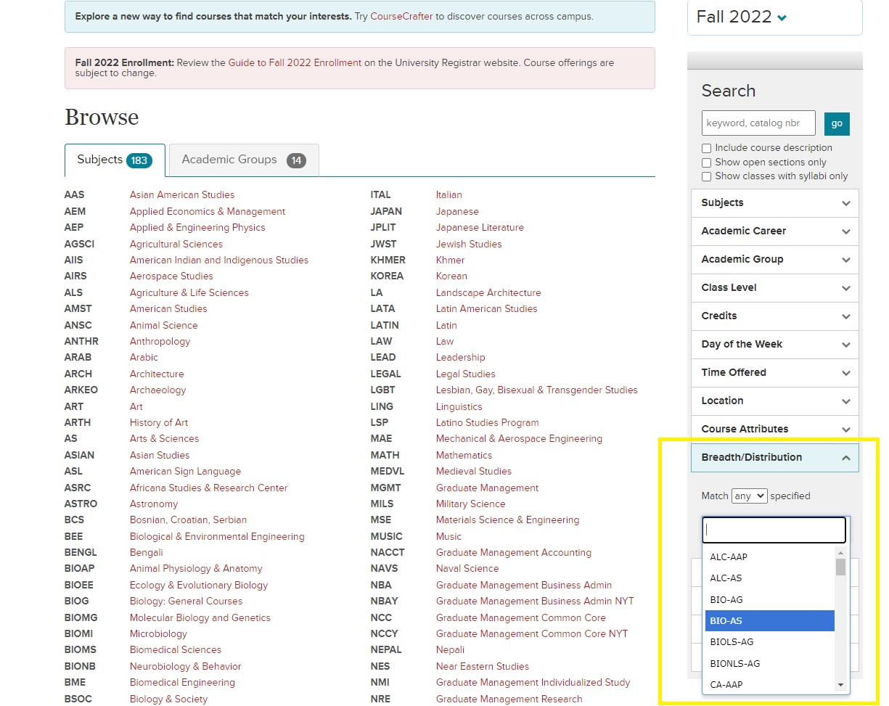
How To Search For Arts and Distribution Electives
Complete list of all Cornell colleges' course codes that meet this requirement
Search the Class Roster for classes that fulfill particular Distribution Categories
Cornell Nolan School of Hotel Administration 14
Notes:
Delete this slide before completing your presentation

Slide 15
Ethics Course
The ethics course requirement is intended to prepare students to think critically and knowledgeably about what is (or should be) considered right or wrong, good or bad, virtue or vice within their personal, professional, and/or public lives.
Approved courses:
AEM 2030: Sports as Society
AEM 3205: Ethics in Business and Organizations ​
BSOC 2061: Ethics & the Environment​
COMM 4300: Ethics in New Media, Technology, and Communication
ECE 2750: Robot Ethic ​
ILRLR 4820: Ethics at Work​
INFO 4301: Ethics in New Media
PHIL 1450: Contemporary Moral Issues
PHIL 2410: Ethics ​
PHIL 3231: Kant’s Ethics​
If you are interested in learning more about what standards a class must meet to qualify as an Ethics course, please consult the 2022-2023 Nolan School Student Handbook.
Cornell Nolan School of Hotel Administration 15
Notes:
Delete this slide before completing your presentation

Slide 16
Diversity and Inclusion Course
The diversity course requirement is intended to provide students with an opportunity to explore the challenges/opportunities to an organization or community stemming from issues related to power, privilege, access, and equity.
Approved courses:
HADM 3960: Seminar in Leadership, Diversity, and Inclusion
AEM 2015: The Business Case for Diversity and Inclusion
AEM 3015: Developing Racial Equity in Organizations
AMST 1104: Race and Ethnicity in the United States: Social Constructs Real World Consequences
AMST 2505/FGSS 2501: Playing out Difference: History and Identity in Sports Film
ANTHR 2470: Island and Gender
ANTHR 3487: Racial Capitalism
ASIAN 2230/CAPS 2230: Introduction to China: Outsiders in History
EDUC 2610: Intergroup Dialogue
FGSS 2010: Introduction to Feminist, Gender, and Sexuality Studies
FGSS 2290: LBGTQ Mental Health
FGSS 2501: Playing out Difference: History and Identity in Sports Film
ILRHR 3640: Diversity & Inclusion
ILRID 2510: Foundations of Diversity Dynamics
NTRES 2000: Environmental Justice
PHIL 1650: Philosophy of Race
If you are interested in learning more about what standards a class must meet to qualify as a Diversity and Inclusion course, please consult the 2022-2023 Nolan School Student Handbook.
Cornell Nolan School of Hotel Administration 16
Notes:
Delete this slide before completing your presentation

Slide 17
Free Electives
8 credit hours required
These credits may be taken for a letter grade OR pass/fail (S/U)
Students can explore any type of academic course to fulfill this requirement at any of Cornell's colleges/schools in or out of the SC Johnson College of Business.
Both HADM 1199 – Hotelie Launchpad (1 cr.) and HADM 1910 - Distinguished Lectures in Hospitality Management (1 cr.) can only count toward Free Electives
Cornell Nolan School of Hotel Administration 17
Notes:
Delete this slide before completing your presentation

Slide 18
Non-Academic Graduation Requirements
Physical Education (PE) - 2 courses
University Swim Test
800 Hours Practice Credit
Cornell Nolan School of Hotel Administration 18
Notes:
Delete this slide before completing your presentation

Slide 19
Swim Test & Physical Education
Physical Education (PE): Taking 2 PE courses is a graduation requirement
The credits DO NOT count toward the 120 academic credits required to graduate.
Registration for PE classes is done online via Student Center.
Cornell Swim Test: Students must take their swim test when offered to meet graduation requirements. The swim test is typically taken during Orientation.
Check the Physical Education website for updates!
Swim Test Dates and Times
Cornell Nolan School of Hotel Administration 19
Notes:
Delete this slide before completing your presentation

Slide 20
Practice Credit
The purpose of Practice Credit is to expose students to a variety of practical work experiences in industries they have a career interest in. This experience enhances the overall business education you receive at the Nolan School of Hotel Administration.
Students must complete 800 hours/2 units of Practice Credits to meet graduation requirements.
Experiences from high school or summer 2022 will not count towards Practice Credit.
Students can only submit a maximum of 1 unit/400 hours of Practice Credit per experience.
To receive 2 units of practice credit from the same organization, the nature of each job must be significantly different and pre-approved by the OSS Practice Credit Team.
For more information, please visit the Practice Credit webpage
Cornell Nolan School of Hotel Administration 30
Notes:
Delete this slide before completing your presentation

Slide 21
Forbidden Overlaps
Nolan students are not permitted to take classes that are Forbidden Overlaps with any HADM Core: It is your responsibility to make sure you are not enrolling in a Forbidden Overlap course.
This will be listed in the course description on the class roster. Students will not receive credit for any class that is a Forbidden Overlap with a core course.
Cornell Nolan School of Hotel Administration 21
Notes:
Delete this slide before completing your presentation

Slide 22
Credit Limit
Each semester, the default credit maximum a student can enroll in is set to 18. Students in their first semester at Cornell cannot request to increase their credit limits until final grades have been posted for Spring 2023. Students with a current cumulative GPA may request to take more than 18 credits, if their cumulative GPA falls within the following ranges:
2.501-2.999=19 credits
3.001-3.499 =20 credits
3.50 and above =21 credits*
*NSHA students cannot take more than 21 credits per semester.
Please e-mail ha-registrar@cornell.edu to request a credit limit increase for Fall 2023. Please note, this credit limit increase is only valid for one semester. Students must make this request each semester if they would like to enroll in more than 18 credits.
Cornell Nolan School of Hotel Administration 26
Notes:
Delete this slide before completing your presentation

Slide 23
Grading Options
Grading Options
Letter Grade ONLY: A+ through D-, F
A passing letter grade is a D- and above
There is no option to change grade option to S/U, cannot be petitioned
Student Option: Letter grade or S/U
There are campus-wide deadlines to make changes to the grade option for applicable classes
Grade cutoff for a ‘S’ is C-
Pass/Fail Only: SX/UX
This grade option cannot be changed to a letter grade
Does not impact GPA
Review the 2022-2023 Key Academic Dates for deadlines to change grading options
Cornell Nolan School of Hotel Administration 27
Notes:
Delete this slide before completing your presentation

Slide 24
Enrollment Error Codes
If you get an error message when you attempt to enroll in a class, please take note of the error message and review the Common Error Messages Guide to determine next best steps
Common Error: 'Available Seats are Reserved'
This means that there are seats available only to a specific population of students, and you are not in that student group. The class will still show that it is 'Open' on Student Center, but you will not be able to enroll if you are not a part of the specified student population
Cornell Nolan School of Hotel Administration 26
Notes:
Delete this slide before completing your presentation

Slide 25
CONTACT OSS
Academic Advising*
ha-advising@cornell.edu
*You are not assigned an Academic Advisor. You can see either of us!
Nolan Registrar Team
ha-registrar@cornell.edu
Practice Credit
ha-practicecredit@cornell.edu
Cornell Nolan School of Hotel Administration 25
Notes:
Edit the text to reflect the resource or office you are highlighting
Use the first line to display the name of the resource or office
Use the second line to display the physical location, web address, and or email of that resource or office.
Delete any extra text

Slide 26
Pre-enrollment Virtual Advising Drop-Ins
We will be holding Virtual 1:1 Pre-Enrollment Drop-Ins at the following times:
Monday April 24 – Thursday April 27
10:00am – 12:00pm EST
2:00pm – 4:00pm EST
Friday April 28
10:00am – 12:00pm EST
2:00pm – 3:00pm EST
Monday May 1 – Thursday May 4
10:00am – 12:00pm EST
2:00pm – 4:00pm EST
Friday May 5
10:00am -12:00pm EST
2:00pm – 3:00pm EST
Drop-Ins are held via Zoom
Meeting ID: 946 8781 2347
Passcode: 624493
Drop-Ins are intended for quick discussions about your Spring 2023 enrollment, and are not intended for extended advising conversations.
Cornell Nolan School of Hotel Administration 26
Notes:
Delete this slide before completing your presentation

