Slide 1


Spring 2023 Enrollment Information Session
With Taylor Sweazey| Friday November 4
Notes:
Insert any pre-title text in the text box at the top (ie. “Presented by…”)
Insert the presentation title in the second text box with the largest text
Insert the speaker’s name and/or the month, day and year of the presentation.
Delete any text boxes you didn’t use.
You are welcome to use the image that is already included. For instructions on how to change the image, view slide 6. In order to keep the transparent look, change the picture’s transparency to 75% in the ”Picture format” pane that should pop up on the right side of the screen.

Slide 2
Agenda
Key Resources
Important Dates
The NSHA Curriculum
Everything Else You Need to Know for Enrollment for Spring 2023
Answering Your Questions!
Cornell Nolan School of Hotel Administration 2
Notes:
Delete this slide before completing your presentation

Slide 3
Getting Answers
STEP 1
USE YOUR RESOURCES
STEP 2
ATTEND VIRTUAL 1:1 ADVISING DROP-INS
STEP 3
E-MAIL THE ADVISING TEAM
If you have questions, please follow this process!
MAKE AN APPOINTMENT
Student Launchpad
Degree Audit
Student Handbook
Pre-Enrollment FAQs
Opportunity to meet with an advisor individually without an appointment!
Offered via Zoom
Students are seen on ‘first come first served’ basis
Individual 30 minute scheduled appointments are intended for students who wish to discuss long term goals and want to do complex planning related to those goals.
Please do not make an appointment for a quick question that could be answered in drop-ins or via email
STEP 4
ha-advising@cornell.edu
Expect a response time of up to 3 business days
Notes:
Delete this slide before completing your presentation

Slide 4
Use Your Resources!
Student LaunchPad
Student Essentials
  Links you to your Student Center to view your pre-enrolled core schedule and enroll in additional courses.
NSHA Resources for Students
  Pre-Enrollment FAQs
  These presentation slides!
  Core Swap Request Form & Instructions
  4 Year Planning Sheet
University Registrar Guide to Spring 2023 Enrollment
  Step by step instructions on how to add a class
Cornell Nolan School of Hotel Administration 4
Notes:
Delete this slide before completing your presentation

Slide 5
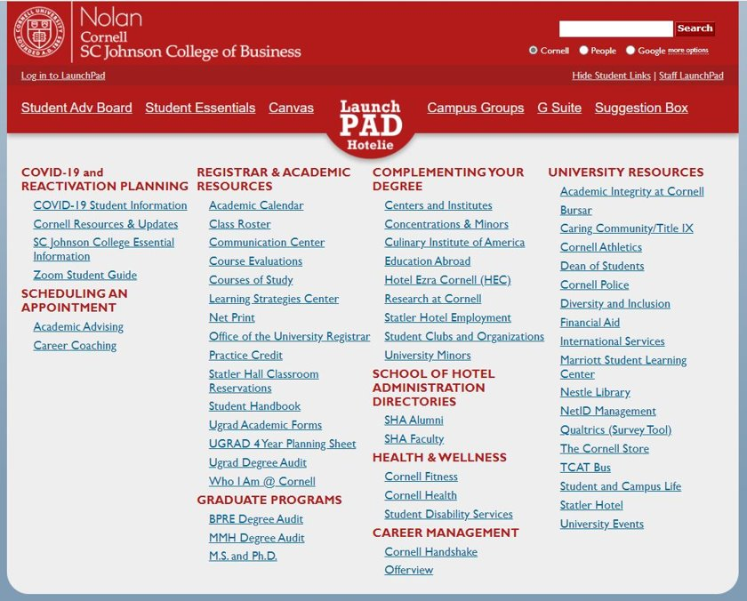
Student LaunchPad Website
Please note: The UGRAD 4 Year Planning Sheet is not relevant for the current fall 2022 curriculum – use the 4 year planning sheet linked on the NSHA Resources for Students page instead
Cornell Nolan School of Hotel Administration 5
Notes:
Delete this slide before completing your presentation

Slide 6
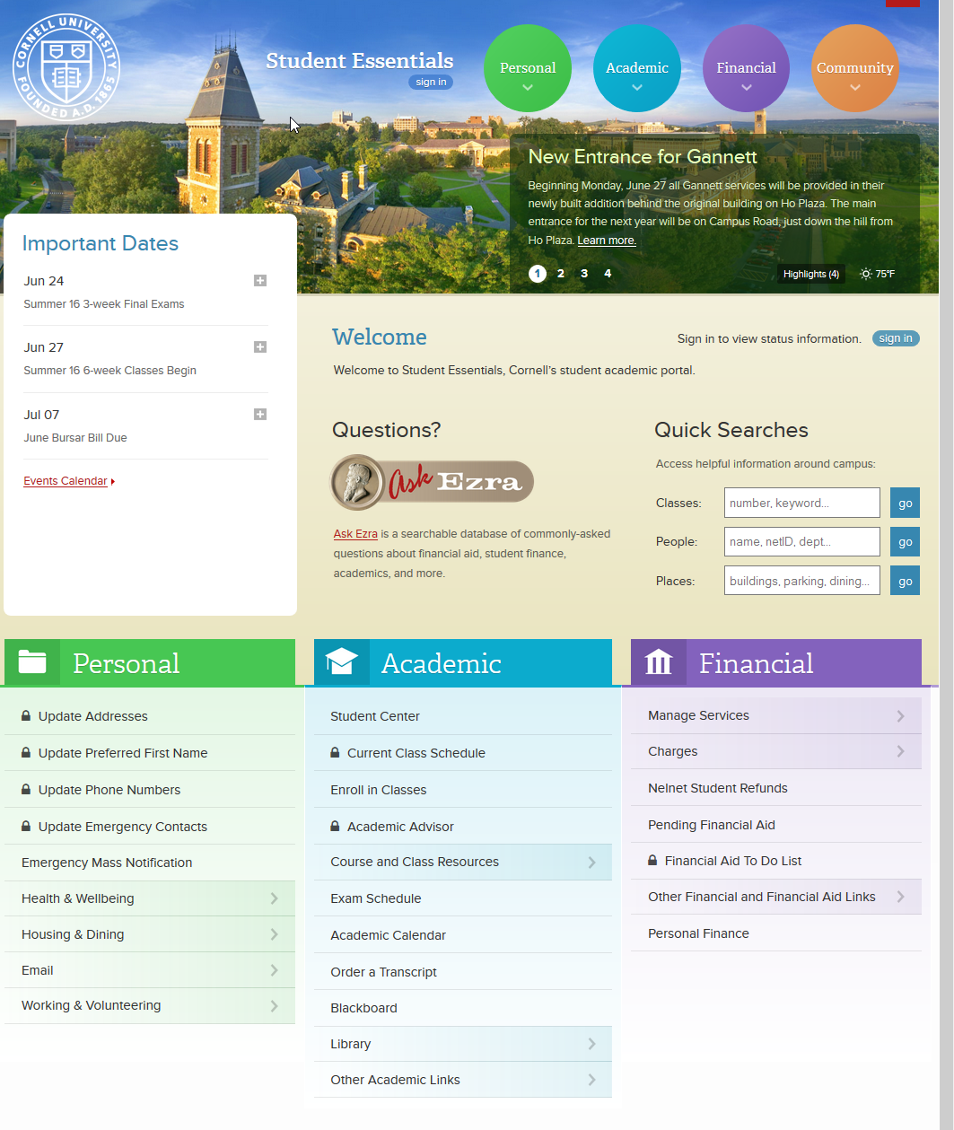
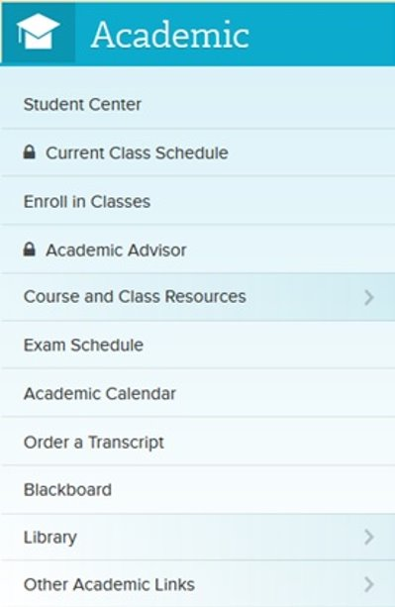
Student Essentials
Cornell Nolan School of Hotel Administration 6
Notes:
Delete this slide before completing your presentation

Slide 7
Virtual 1:1 Pre-Enrollment Drop-Ins
We will be holding Virtual 1:1 Pre-Enrollment Drop-Ins at the following times:
  Monday October 31 – Thursday November 3
    10:00am – 12:00pm
    2:00pm – 4:00pm
  Friday November 4
    10:00am – 12:00pm
    2:00pm – 3:00pm
  Monday November 7 – Thursday November 10
    10:00am – 12:00pm
    2:00pm – 4:00pm
  Friday November 11
    10:00am – 12:00pm
    2:00pm – 3:00pm
Drop-Ins are held via Zoom
Meeting ID: 946 8781 2347
Passcode: 624493
Cornell Nolan School of Hotel Administration 7
Notes:
Delete this slide before completing your presentation

Slide 8
Key Academic Dates
November 7 at 7:30am – November 9 at 11:59pm: Pre-Enrollment for Juniors
November 8 at 7:30am – November 10 at 11:59pm: Pre-Enrollment for Sophomores
November 9 at 7:30am – November 11 at 11:59pm: Pre-Enrollment for First Years
Review the 2022-2023 Key Academic Dates for more important dates and deadlines!
Cornell Nolan School of Hotel Administration 8
Notes:
Delete this slide before completing your presentation

Slide 9
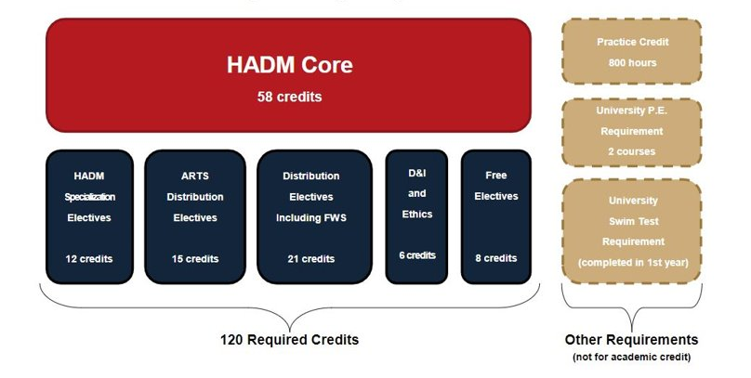
Undergraduate Degree Requirements
Cornell Nolan School of Hotel Administration 9
Notes:
Delete this slide before completing your presentation

Slide 10
Hotel Administration (HADM) Core
1000-Level
HADM 1150: Org. Behavior & Leadership Skills
HADM 1210: Financial Accounting
HADM 1350: Intro. to Hotel Operations
HADM 1361: Principles of F&B Operations Mgmnt.
HADM 1410: Microeconomics
HADM 1650: Business Writing
HADM 1740: Business Computing
2000-Level
HADM 2011: Hospitality Quant. Analysis
HADM 2021: Critical Thinking & Mathematical Modeling in Operations
HADM 2210: Managerial Accounting
HADM 2220: Finance
HADM 2221: Principles of Hospitality Real Estate
HADM 2351: Restaurant Management
HADM 2430: Marketing Mgmnt. For Services
HADM 2560: Fundamentals Of Hospitality Development & Mgmnt.
HADM 2810: Human Resources Mgmnt.
3000-Level
HADM 3650: Persuasive Business Communication for Hospitality Leaders
HADM 3870: Business & Hospitality Law
4000-Level
HADM 4410: Strategic Mgmnt.
Students will be pre-enrolled into all 1000-level and all but two, 2000-level core classes by the NSHA registrar team in until they are complete.​
  Students can self-enroll in HADM 2210 and HADM 2810, once they have met the course pre-requisites.​
Students have the autonomy to enroll themselves into HADM 2210 and HADM 2810 as well as 3000-level and 4000-level core once they have met the course pre-requisites.
Cornell Nolan School of Hotel Administration 10
Notes:
Delete this slide before completing your presentation

Slide 11
Core Class 'Blocks'
The Nolan School registrar team has pre-enrolled you into a Core Block as well as HADM 1410 Microeconomics and HADM 2011 Hospitality Quantitative Analysis
Students are not permitted to drop 1000-level and 2000-level HADM core courses.
Holds
If you log in to your Student Center and do not see that you have been enrolled in classes, this likely means that you have a HOLD on your account. It is imperative that you take steps to release your hold(s) as soon as possible.
  To check your holds, first sign into your Student Center
  Next, check for ‘Holds’ on the right side of the screen
  Click on ‘Details’ to read more about your hold(s), and instructions on how to remove them
  Take the appropriate steps to remove the hold, and e-mail ha-registrar@cornell.edu to announce you have removed your hold(s)
If your holds are not removed by next week you will not be able to participate in pre-enrollment
Cornell Nolan School of Hotel Administration 11
Notes:
Delete this slide before completing your presentation

Slide 12
1000-Level Hotel Administration (HADM) Core
Fall | Spring
All Students
HADM 1199 – Hotelie LaunchPad (Students are pre-enrolled into this 1 credit course, but it is not considered a core course) | HADM 1410 – Microeconomics for the Service Industry
HADM 1910 – Distinguished Lectures in Hospitality Management (Students are pre-enrolled into this 1 credit course, but it is not considered a core course) | HADM 2011 - Hospitality Quantitative Analysis
HADM 1740 - Business Computing
Block 1 Students | Block 1 Students
HADM 1210 – Financial Accounting | First Year Writing Seminar (Students must enroll themselves into a First Year Writing Seminar of their choice)
HADM 1350 – Introduction to Hotel Operations | HADM 1361 – Introduction to Foodservice Management
HADM 1650 – Business Writing | HADM 1150 – Organizational Behavior & Leadership Skills
Block 2 Students | Block 2 Students
First Year Writing Seminar (Students must enroll themselves into a First Year Writing Seminar of their choice) | HADM 1210 – Financial Accounting
HADM 1361 – Principles of Food & Beverage Ops. Mgmnt. | HADM 1350 – Introduction to Hotel Operations
HADM 1150 – Organizational Behavior & Leadership Skills | HADM 1650 – Business Writing
Cornell Nolan School of Hotel Administration 12
Notes:
Delete this slide before completing your presentation

Slide 13
2000-Level HADM Core
Fall | Spring
All Students
HADM 2220 - Finance | HADM 2221 – Principles of Hospitality in Real Estate
Block 1 Students | Block 1 Students
HADM 2430- Marketing Management for Services | HADM 2351 – Restaurant Management
HADM 2021 – Critical Thinking & Mathematical Modeling in Operations | HADM 2560 – Fundamentals of Hospitality Development & Management
Block 2 Students | Block 2 Students
HADM 2351 – Restaurant Management | HADM 2430- Marketing Management for Services
HADM 2560 – Fundamentals of Hospitality Development & Management | HADM 2021 – Critical Thinking & Mathematical Modeling in Operations
Transfer students are often not enrolled into perfect blocks due to transfer credit
Students can self-enroll in HADM 2210 and HADM 2810 once they have met the pre-requisites for these courses:
  HADM 2210 – Pre-requisite is HADM 1210
  HADM 2810 – Pre-requisite is HADM 1150
Cornell Nolan School of Hotel Administration 13
Notes:
Delete this slide before completing your presentation

Slide 14
Details About Pre-Enrolled Core Classes
First year students are not permitted to add additional core beyond the block that you are pre-enrolled into.
Core Section Swap Requests:
  The electronic core section swap process allows students enrolled in 1000-level and 2000-level HADM core courses to request to swap from one course section into another section of the same course (example: request to swap from HADM 1210 Lecture 001 to HADM 1210 Lecture 002)
  Swap Requests are not guaranteed, but the registrar team will try to accommodate as many swaps as possible
  Swap requests will be accepted until August 28, 2022 using the Swap Request Form
  Swapping a full core 'block' for another 'block' cannot be done
Cornell Nolan School of Hotel Administration 14
Notes:
Delete this slide before completing your presentation

Slide 15
Self-Enrolled HADM Core
You Enroll Yourself! (Once you have met the pre-requisites)
HADM 2210 Managerial Accounting – Pre-requisite: HADM 1210
HADM 2810 Human Resources Management – Pre-requisite: HADM 1150
HADM 3650 Persuasive Business Communication – Pre-requisite: HADM 1650
HADM 3870 Business and Hospitality Law – Pre-requisite: HADM 2810
HADM 4410 Strategic Management – Pre-requisites: HADM 2021, HADM 2211, HADM 2351, HADM 2430, HADM 2560, HADM 2810, HADM 3650
For Spring 2023 ONLY HADM 2210 and HADM 2810 are not self-enrolled courses
  If you are interested in adding one of these classes to your schedule for next semester, please come to drop-ins to discuss your personal plan
  We will accept requests to be added to these classes. These requests will be reviewed in January
Cornell Nolan School of Hotel Administration 15
Notes:
Delete this slide before completing your presentation

Slide 16
Reminder about Test Credit
Sending in your scores!
  Advanced Placement (AP): Send your scores via Collegeboard (CEEB Code 2098)
  International Baccalaureate (IB): Send scores through IB Office. Email ha-registrar to notify them you have sent your scores
  A-Level: Students must present original or certified copy of their exam certificate. Visit Cambridge International webpage for more info. Email ha-registrar@cornell.edu to notify them you have sent your scores.
Cornell Nolan School of Hotel Administration 16
Notes:
Delete this slide before completing your presentation

Slide 17
Test Credit Continued…
With qualifying scores, NSHA students may be awarded college credit toward Arts Distribution or Distribution Electives, with the following exceptions:
  A score of 5 on AP English Language and Comp or AP English Literature and Comp will fulfill the First-Year Writing Seminar
  A score of 7 on the higher level IB-HL exam for English Literature and Comp will fulfill the First Year Writing Seminar
  A score of A* or A on General Certificate of Education Advanced (“A”) Level Examinations in English Literature will fulfill FWS
  A score of 5 on AP Microeconomics will fulfill HADM 1410
  A score of 7 on IB-HL Microeconomics will fulfill HADM 1410
  A score of A* or A on General Certificate of Education Advanced (“A”) Level Examinations in Economics will fulfill HADM 1410
A maximum of 15 test credits can be applied towards your Nolan Degree requirements. For more information regarding sources of Advanced Placement Credit refer to the Courses of Study.
Cornell Nolan School of Hotel Administration 17
Notes:
Delete this slide before completing your presentation

Slide 18
HADM Specialization Electives
12 credits required
These credits must be completed as a letter grade unless offered SX/UX
Transfer students can declare their specialization as early as next semester. First year students will declare their Specialization starting first semester Sophomore year. All students can modify their selection up until the first semester of their senior year
Classes that count toward each Specialization will be posted online in spring 2023
Options:
  The Business of Hospitality Specialization: Finance track, Analytics track, or Services Marketing track
  Hospitality Operations Specialization: Foodservice Management track or Beverage Management track
  Real Estate Minor
Cornell Nolan School of Hotel Administration 18
Notes:
Delete this slide before completing your presentation

Slide 19
Distribution Requirements
42 Credits Total
Arts Electives – 15 credits. You must take 3 credits minimum in at least 3 of the following 5 categories in the College of Arts and Sciences: Arts, Literature, and Culture & Historical Analysis (coded ALC-AS or HST-AS) Global Citizenship & Social Difference (coded GLC-AS or SCD-AS) Social Sciences (coded SSC-AS) Symbolic and Mathematical Reasoning & Statistics and Data Science (coded SMR-AS or SDS-AS) Biological Sciences & Physical Sciences (coded BIO-AS or PHS-AS)
Distribution Electives – 21 credits total, including FWS Courses that meet the Liberal Arts & Sciences requirement from any College or School at Cornell, including the Nolan School.
Ethics course – 3 credits
Diversity and Inclusion (D&I) - 3 credits
Cornell Nolan School of Hotel Administration 16
Notes:
Delete this slide before completing your presentation

Slide 20
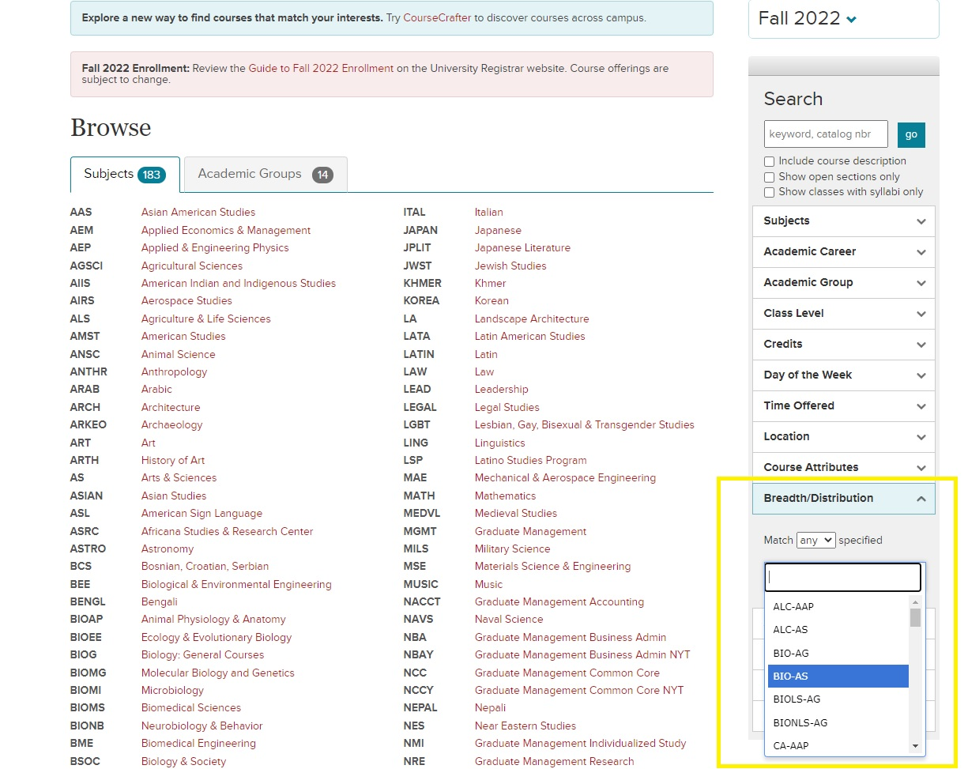
How To Search For Arts and Distribution Electives
Complete list of all Cornell colleges' course codes that meet this requirement
Search the Class Roster for classes that fulfill particular Distribution Categories
Cornell Nolan School of Hotel Administration 20
Notes:
Delete this slide before completing your presentation

Slide 21
First-Year Writing Seminar
All new First Year Students must complete a First-Year Writing Seminar (FWS)
  This academic requirement is manage by the Knight Institute
  FWS is a 3-credit course that will count toward your 42 credits of Distribution Electives
Students currently enrolled in Block 1 must enroll themselves into a FWS for Spring 2023 during pre-enrollment
  If you received Test Credit for the FWS, please add an additional elective of your choice to your schedule
Cornell Nolan School of Hotel Administration 21
Notes:
Delete this slide before completing your presentation

Slide 22
Ethics Course
The ethics course requirement is intended to prepare students to think critically and knowledgeably about what is (or should be) considered right or wrong, good or bad, virtue or vice within their personal, professional, and/or public lives.
Example courses:
  PHIL 2410: Ethics
  AEM 3205: Ethics in Business and Organizations
  BSOC 2061: Ethics & the Environment
  PHIL 3231: Kant’s Ethics
  ILRLR 4820: Ethics at Work
  ECE 2750: Robot Ethic
  and many more!
    If you are interested in learning more about what standards a class must meet to qualify as an Ethics course, please consult the 2022-2023 Nolan School Student Handbook.
Cornell Nolan School of Hotel Administration 22
Notes:
Delete this slide before completing your presentation

Slide 23
Diversity and Inclusion Course
The diversity course requirement is intended to provide students with an opportunity to explore the challenges/opportunities to an organization or community stemming from issues related to power, privilege, access, and equity.
Example courses:
  HADM 3960: Seminar in Leadership, Diversity, and Inclusion
  ILRHR 3640: Diversity & Inclusion
  AEM 3015: Developing Racial Equity in Organizations
  FGSS 2010: Introduction to Feminist, Gender, and Sexuality Studies
  ANTHR 3487: Racial Capitalism
  NTRES 2000: Environmental Justice
  And many more!
    If you are interested in learning more about what standards a class must meet to qualify as an Diversity and Inclusion course, please consult the 2022-2023 Nolan School Student Handbook.
Cornell Nolan School of Hotel Administration 23
Notes:
Delete this slide before completing your presentation

Slide 24
Free Electives
8 credit hours required
These credits may be taken for a letter grade OR pass/fail (S/U)
Students can explore any type of academic course to fulfill this requirement at any of Cornell's colleges/schools in or out of the SC Johnson College of Business.
Both HADM 1199 – Hotelie Launchpad (1 cr.) and HADM 1910 - Distinguished Lectures in Hospitality Management (1 cr.) count toward Free Electives
Cornell Nolan School of Hotel Administration 24
Notes:
Delete this slide before completing your presentation

Slide 25
Non-Academic Graduation Requirements
Physical Education (PE) - 2 courses
University Swim Test
800 Hours Practice Credit
Cornell Nolan School of Hotel Administration 25
Notes:
Delete this slide before completing your presentation

Slide 26
More About The Swim Test & Physical Education
Physical Education (PE): Taking 2 PE courses is a graduation requirement
  The credits DO NOT count toward the 120 academic credits required to graduate.
  Registration for PE classes is done online via Student Center.
Cornell Swim Test: Students must take their swim test when offered to meet graduation requirements. The swim test is typically taken during Orientation.
  Check the Physical Education website for updates!
  Swim Test Dates and Times
Cornell Nolan School of Hotel Administration 26
Notes:
Delete this slide before completing your presentation

Slide 27
Practice Credit
The purpose of Practice Credit is to expose students to a variety of practical work experiences in industries they have a career interest in. This experience enhances the overall business education you receive at the Nolan School of Hotel Administration.
  Students must complete 800 hours/2 units of Practice Credits to meet graduation requirements.
    Experiences from high school or summer 2022 will not count towards Practice Credit.
  Students can only submit a maximum of 1 unit/400 hours of Practice Credit per experience.
  To receive 2 units of practice credit from the same organization, the nature of each job must be significantly different and pre-approved by the OSS Practice Credit Team.
For more information, please visit the Practice Credit webpage
Cornell Nolan School of Hotel Administration 30
Notes:
Delete this slide before completing your presentation

Slide 28
Forbidden Overlaps
Nolan students are not permitted to take classes that are Forbidden Overlaps with any HADM Core: It is your responsibility to make sure you are not enrolling in a Forbidden Overlap course.
This will be listed in the course description on the class roster. Students will not receive credit for any class that is a Forbidden Overlap with a core course.
Cornell Nolan School of Hotel Administration 28
Notes:
Delete this slide before completing your presentation

Slide 29
Credit Limit
Cornell Nolan School of Hotel Administration 26
Notes:
Delete this slide before completing your presentation

Slide 30
Grading Options
Grading Options
  Letter Grade ONLY: A+ through D-, F
    A passing letter grade is a D- and above
    There is no option to change grade option to S/U, cannot be petitioned
  Student Option: Letter grade or S/U
    There are campus-wide deadlines to make changes to the grade option for applicable classes
    Grade cutoff for a ‘S’ is C-
  Pass/Fail Only: SX/UX
    This grade option cannot be changed to a letter grade
    Does not impact GPA
Review the 2022-2023 Key Academic Dates for deadlines to change grading options
Cornell Nolan School of Hotel Administration 27
Notes:
Delete this slide before completing your presentation

Slide 31
QUESTIONS?
Cornell Nolan School of Hotel Administration 31
Notes:
You should not have to make any edits to this slide.

Slide 32
Reminder: Pre-enrollment Virtual Advising Drop-Ins
Virtual 1:1 Pre-Enrollment Drop-In Advising Schedule
  Monday October 31 – Thursday November 3
    10:00am – 12:00pm
    2:00pm – 4:00pm
  Friday November 4
    10:00am – 12:00pm
    2:00pm – 3:00pm
  Monday November 7 – Thursday November 10
    10:00am – 12:00pm
    2:00pm – 4:00pm
  Friday November 11
    10:00am – 12:00pm
    2:00pm – 3:00pm
Drop-Ins are held via Zoom
Meeting ID: 946 8781 2347
Passcode: 624493
Drop-Ins are intended for quick discussions about your Spring 2023 enrollment, and are not intended for extended advising conversations.
Cornell Nolan School of Hotel Administration 32
Notes:
Delete this slide before completing your presentation

Slide 33
CONTACT OSS
Academic Advising* (Taylor)
ha-advising@cornell.edu
*You are not assigned an Academic Advisor. You can see either of us!
Nolan Registrar Team
ha-registrar@cornell.edu
Practice Credit
ha-practicecredit@cornell.edu
A PDF of this slideshow, as well as a recording of this presentation will be e-mailed to you.
Cornell Nolan School of Hotel Administration 33
Notes:
Edit the text to reflect the resource or office you are highlighting
Use the first line to display the name of the resource or office
Use the second line to display the physical location, web address, and or email of that resource or office.
Delete any extra text

Slide 34
THANK YOU!
Notes:
You should not have to make any edits to this slide.

